Slide 1
Exploring New Frontiers in Imbalanced Learning: Data Complexity-Based Solutions
Asif Newaz
ID: 2022-2-96-004
Supervised by: Dr. taskeEd jabid

Slide 2
Contents
Overview of Imbalanced classification problem
Motivations and Objectives
Contributions
Efficacy analysis of popular methods
Proposed algorithm: iCost
Proposed algorithm: UniSyn
Proposed algorithm: iBRF
Proposed algorithm: Hierarchical decomposition framework
Conclusion
Publications

Slide 3
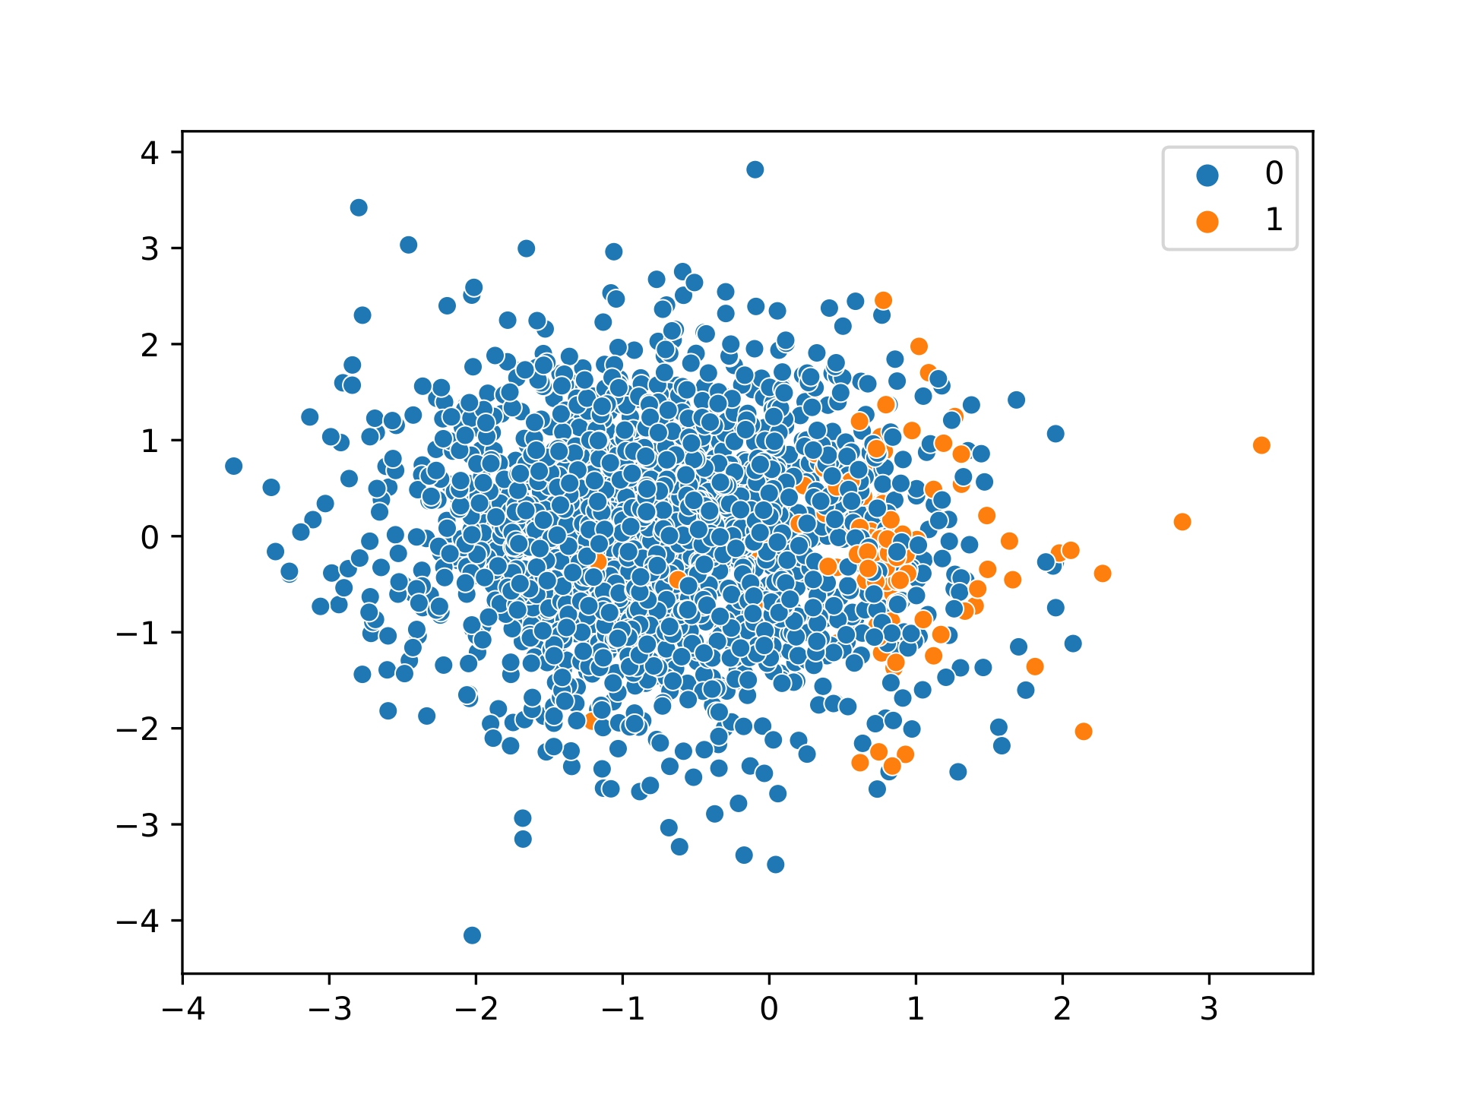
Imbalanced Classification Problem
Class imbalance is a major problem in classification tasks.
When there is an unequal distribution of samples in different classes, traditional classification algorithms gets biased towards the majority class.
This results in a high accuracy in predicting majority class instances but very poor performance on the minority class.
The problem is severe as the minority class usually represents the critical cases e.g., positive cases in cancer diagnosis.
Fig. 1. Class imbalance in data
3

Slide 4
Learning From Imbalanced Data
Different algorithms have been proposed to address the class imbalanced scenarios in data [1].
These algorithms can be broadly classified into two categories.
Data-level approach: Resampling the original distribution in the data to reduce imbalance or overlapping.
Algorithm-level approach: Cost-sensitive learning – applying higher misclassification cost to minority class instances.
[1] A. Fernández, S. García, M. Galar, R. C. Prati, B. Krawczyk, and F. Herrera, Learning from imbalanced data sets. Springer, 2018, vol. 10, no. 2018.

Slide 5
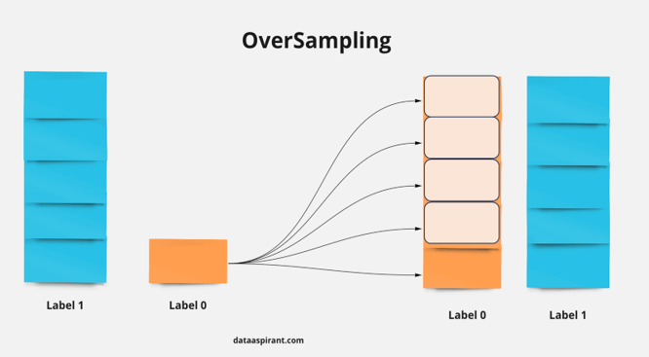
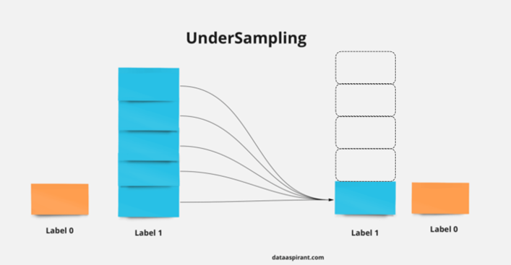
Data Level Approach
Oversampling (OS): Generating new minority class instances.
Undersampling (US): Eliminating instances from the majority class.
Hybrid Sampling (HS): Hybridization between multiple OS and US techniques.
Ensemble: Integrating OS, US or HS techniques into the ensemble learning frameworks.
Fig. 2: Oversampling and Undersampling process
5

Slide 6
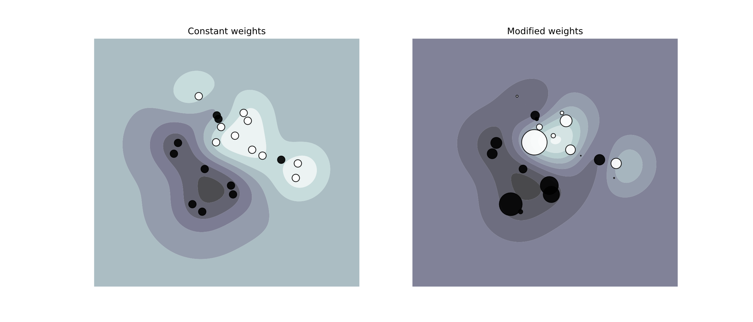
Algorithmic Level Approach
Modify the cost-function of the standard algorithms to adapt them to the imbalanced scenarios.
Higher misclassification costs are assigned to minority-class instances, making the algorithm more sensitive to errors involving those instances.
Fig. 3: Effect of modifying weights of instances.
6

Slide 7
Popular Approaches
A wide variety of techniques have been developed over the years for imbalanced classification task. Some of the most popular approaches are as follows.
Oversampling
SMOTE (Synthetic Minority Oversampling Technique)
G-SMOTE (Geometric SMOTE)
BS-SMOTE (Borderline SMOTE)
ADASYN (Adaptive SMOTE)
DB-SMOTE (Density Based SMOTE)
ROSE (Random oversampling examples)
ProWsyn (Proximity Weighted Synthetic oversampling)
Undersampling
RUS (Random Undersampling)
IRUS (Inverse Random Undersampling)
IHT (Instance Hardness Threshold)
ENN (Edited Nearest Neighbors)
NCL (Neighborhood Cleaning Rule)
CBEUS (Cluster Based Evolutionary Undersampling)
7

Slide 8
Popular Approaches
Hybrid Sampling
SMOTE-ENN
SMOTE-CNN
SMOTE-Tomek
Random Balance
Ensemble approaches
BRF (Balanced Random Forest) – Bagging + RUS
RUSBoost - AdaBoost + RUS
OverBagging – Bagging + ROS
SMOTE-Bagging – Bagging + SMOTE
SMOTE-Boosting – Boosting + SMOTE
SMOTE is the most widely used technique used in the imbalanced domain. Around a hundred variants of SMOTE has been developed [2].
[2] A. Fernández, S. Garcia, F. Herrera, and N. V. Chawla, “Smote for learning from imbalanced data: progress and challenges, marking the 15-year anniversary,” Journal of artificial intelligence research, vol. 61, pp. 863–905, 2018.
8

Slide 9
What Makes Imbalanced Classification So Difficult?
There are several data difficulty factors that increases the complexity of learning from imbalanced data [3].
Rarity of the samples: When the number of minority-class samples available is limited, it makes it difficult for the classifiers to learn accurate patterns from the data.
Imbalance Ratio (IR): When the data is skewed, classifiers naturally become biased towards the majority class.
Class Overlapping: Overlap makes it difficult for a classification algorithm to distinguish between the classes, leading to increased misclassifications. When the data is skewed, it exacerbates the difficulty of accurately identifying instances of the minority class.
Noisy samples: Noisy instances are naturally there in the data due to mislabeling or other reasons. Generating synthetic samples also introduce more noise. Training models on such data results in increased overfitting.
Small disjuncts: It refers to subsets of the minority class that are sparsely represented in the feature space, often isolated from other instances of the same class. Identifying these instances are particularly challenging as they may not capture the overall structure of the minority class.
[3] A. Fernández, S. Garcia, F. Herrera, and N. V. Chawla, “Smote for learning from imbalanced data: progress and challenges, marking the 15-year anniversary,” Journal of artificial intelligence research, vol. 61, pp. 863–905, 2018.

Slide 10
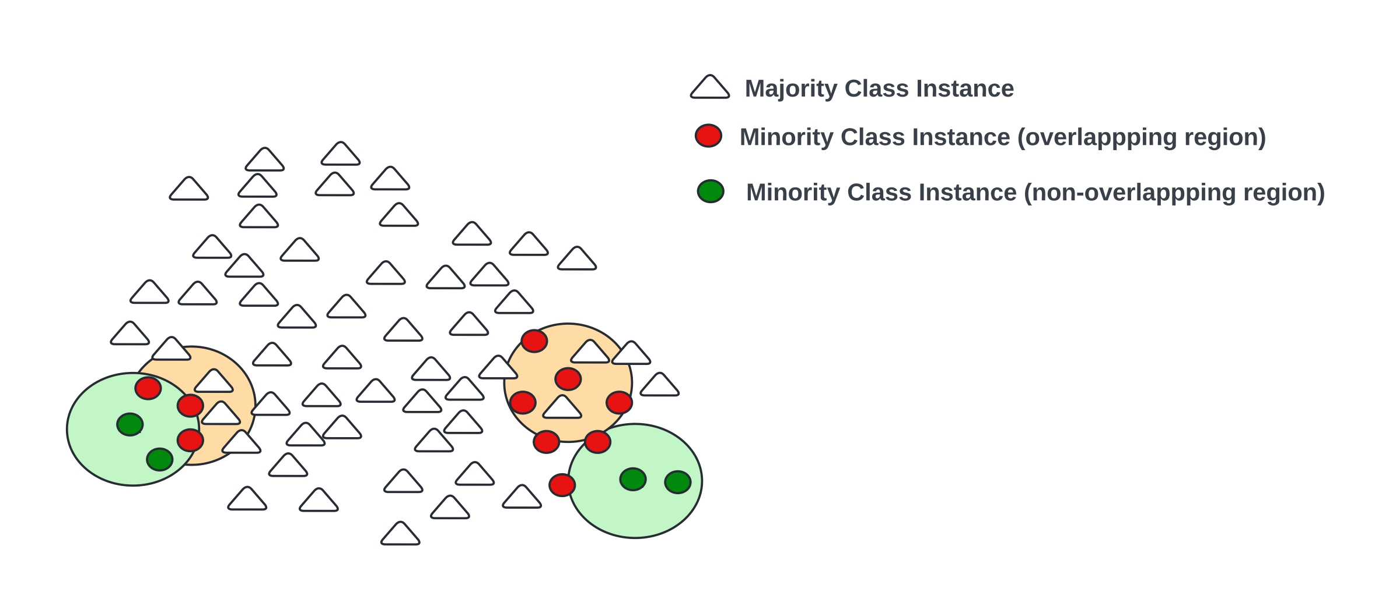
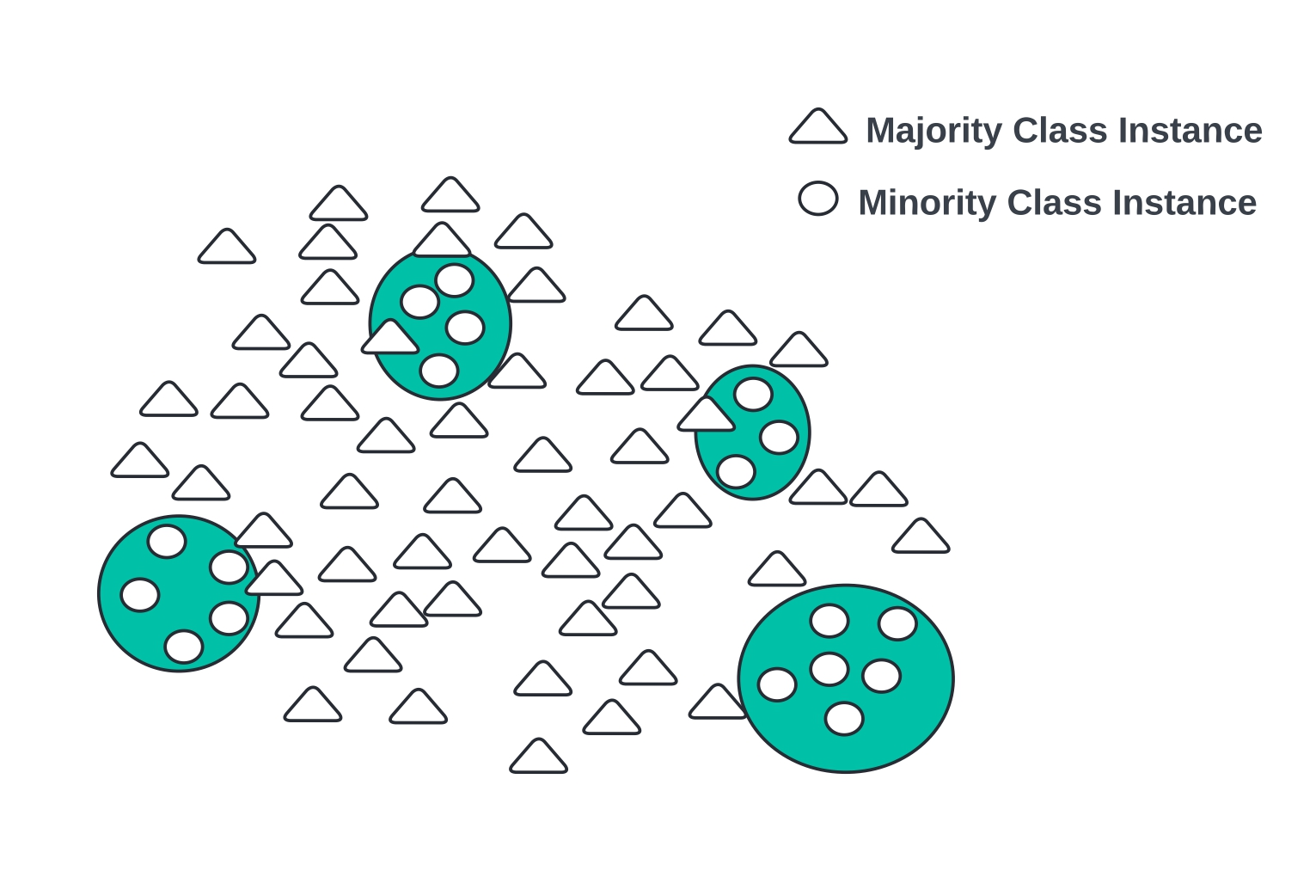
Data Difficulty Factors
Fig. 4: Class overlap
Fig. 5: Small disjuncts
10

Slide 11
Motivation and Objective
While a plethora of approaches have been developed for imbalanced classification tasks, a very limited amount of research has been conducted to analyze the efficacy of the established techniques on a wide variety of imbalanced datasets.
1
Understanding the strengths and weak points of the techniques can guide the development of new, more robust approaches.
2
It has been observed during investigations that the popular approaches don’t work well in many imbalanced scenarios, particularly in highly imbalanced datasets.
3
Developing new approaches that can overcome the limitations of the state-of-the-art techniques and provide well generalized performance is one of the primary goals of this thesis.
4
Most of the established techniques do not take into account all the data difficulty factors. Addressing these factors properly can improve prediction performance.
5

Slide 12
Contributions
A detailed experimental study has been carried out on a wide range of imbalanced datasets to observe the performance of popular techniques used in imbalanced learning. Several major limitations of these approaches have been identified.
1
A novel data resampling methodology has been proposed. This approach is aimed at minimizing the effect of the data difficulty factors while also addressing the limitations of the popular approaches.
2
The developed sampling technique is integrated into the bagging ensemble framework for more generalized performance.
3
A novel instance complexity-based CS framework has been proposed. While traditional CS approaches penalize all the minority-class instances equally, in the proposed approach, instances are weighted according to their difficulty level.
4
A novel multilevel decomposition strategy has been proposed for multiclass classification. This is aimed at improving the performance over traditional OVO or OVA techniques.
5

Slide 13
Efficacy Analysis of Different Techniques used in Imbalanced Learning
An experimental study was conducted on 84 imbalanced datasets with different degrees of imbalance and overlapping to evaluate the performance of 30 different state-of-the-art techniques.
Experimental Framework:
The datasets were collected from various public repositories such as UCI and KEEL.
Two different classification algorithms - SVM and RF were utilized as the base learning classifier.
A repeated 5-fold stratified cross-validation strategy was adopted for performance evaluation.
Mainly composite metrics like MCC, ROC-AUC and G-mean was considered for performance measure.
The IR of the datasets varied from 1.8 to 129. For ease of discussion, the datasets were grouped into 3 categories based on their IR.
Low imbalance: IR<10
Mid imbalance: IR=10-30
High imbalance: IR>30

Slide 14
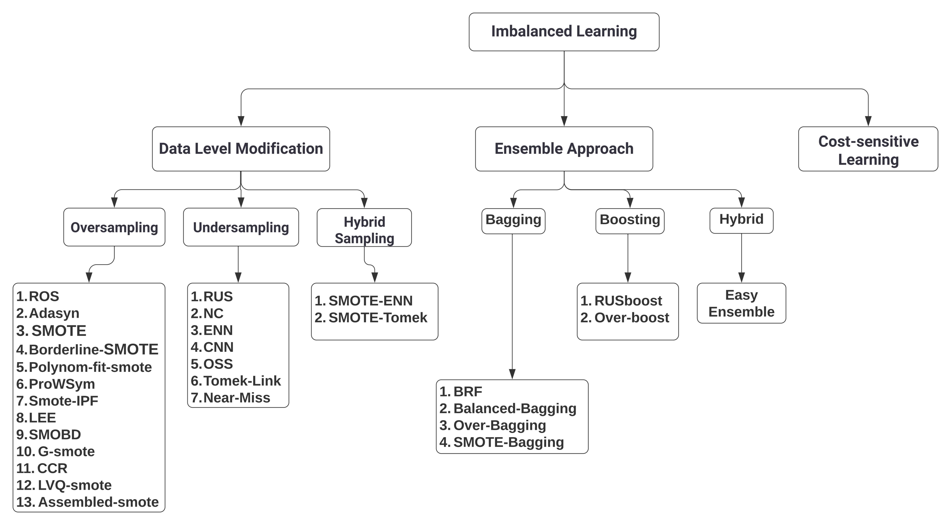
Methodologies Utilized in the Experiment
Fig. 6: Methodologies

Slide 15
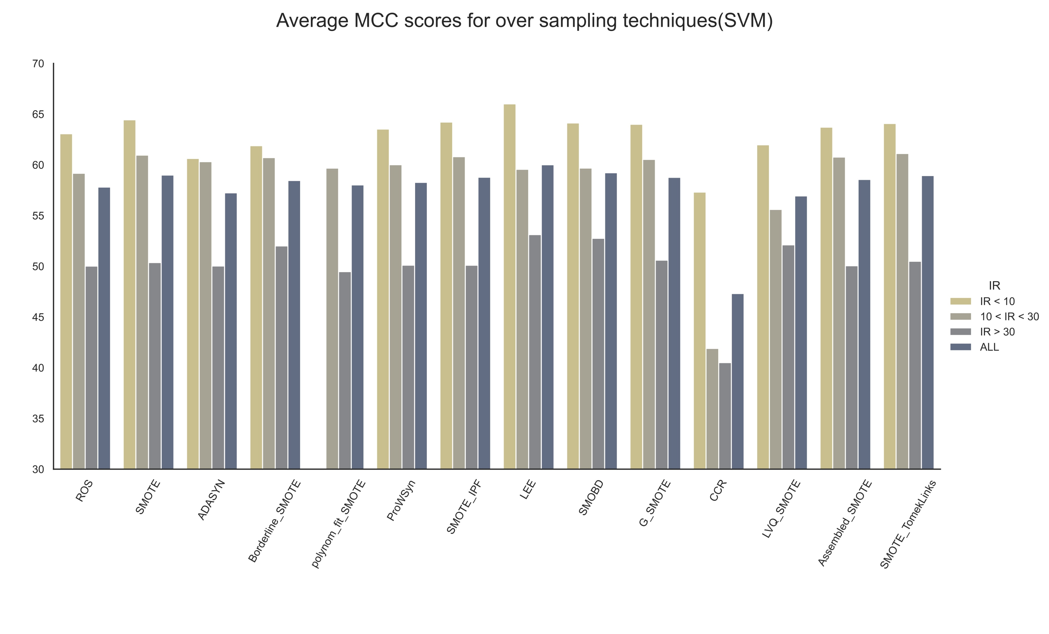
Performance Analysis of Oversampling Techniques
There is a noticeable decline in performance in higher imbalances.
High IR necessitates the generation a substantial number of new samples to balance the dataset.
Generating too many new samples from a limited number of examples can produce noisy samples that may not accurately represent the minority class.
Most of the OS approaches do not address the issue of overlapping.

Slide 16
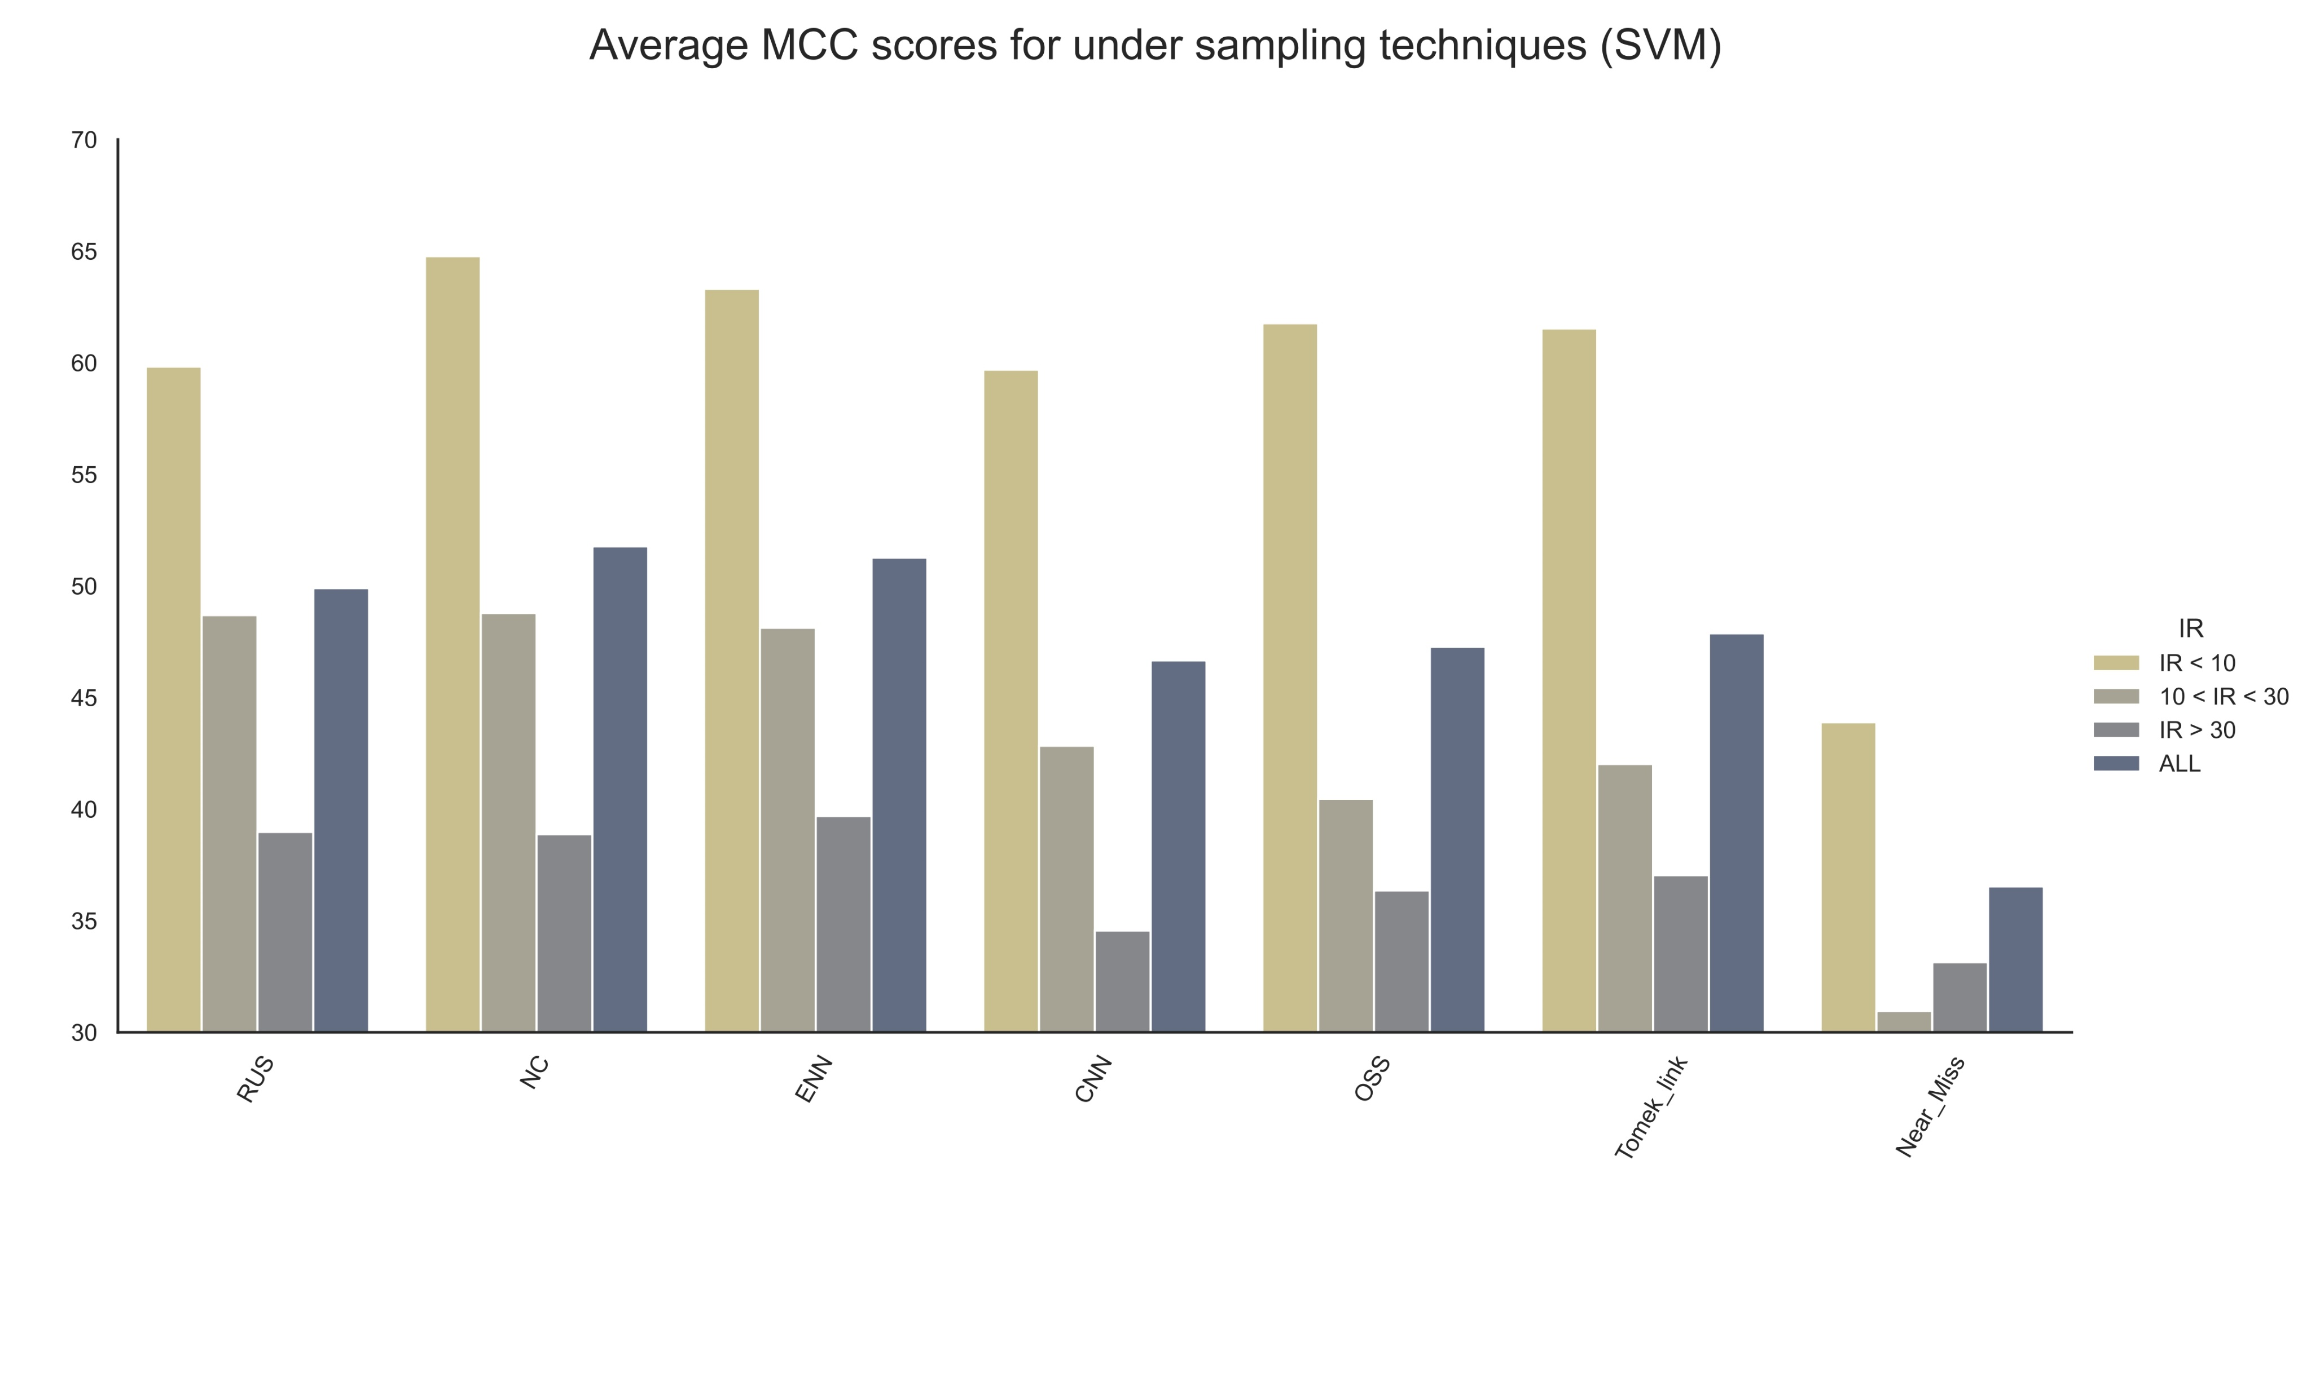
Performance Analysis of Undersampling Techniques
Perform well in lower IR, but all showed a significant decline in performance as the IR increased.
Removing samples from the data might cause loss of valuable information.
They do not increase the presence of minority-class instances in the feature space.

Slide 17
Performance Analysis of Undersampling Techniques
There are two types of US techniques:
Distribution-based: Eliminates as many samples required to balance class distribution.
Overlap-based: Use certain heuristics to carefully select samples for removal that will reduce overlapping.
Overlap-based approaches fail to balance the data adequately. In higher imbalances, the data remains significantly imbalanced. Consequently, these techniques fail to shift the bias.
For distribution-based approaches, in the case of highly imbalanced scenarios, removing too many samples leads to very poor prediction performance due to significant loss of information.

Slide 18
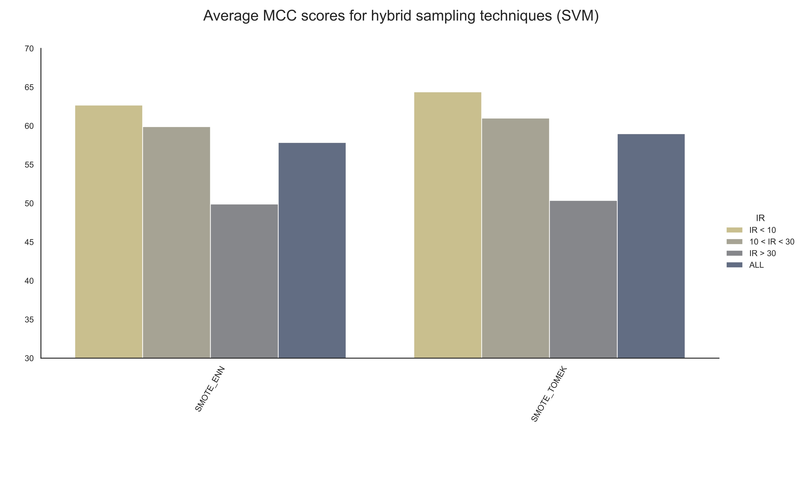
Performance Analysis of Hybrid Sampling Techniques
In general, hybridization did not produce much improvement over SMOTE and its variants.
However, they are particularly useful in highly imbalanced scenarios.
Hybridization has promising potential as they can simultaneously address both class overlapping and imbalance problems.
The exploration of hybrid methods in the existing literature remains relatively limited.

Slide 19
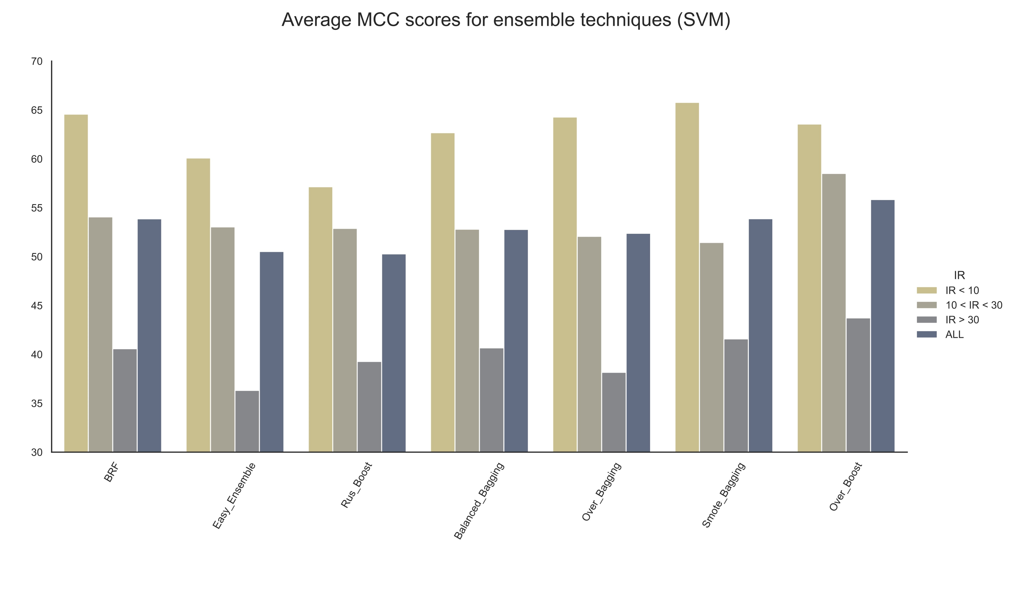
Performance Analysis of Ensemble Techniques
Ensemble approaches by themselves do not solve the imbalanced classification problem. Therefore, much improvement in performance is not realized in imbalanced cases.
Most ensembles did not outperform the US techniques, and their performance was notably poor on highly imbalanced datasets.
To achieve better outcomes, the underlying sampling techniques must first address the issues of imbalanced learning.

Slide 20
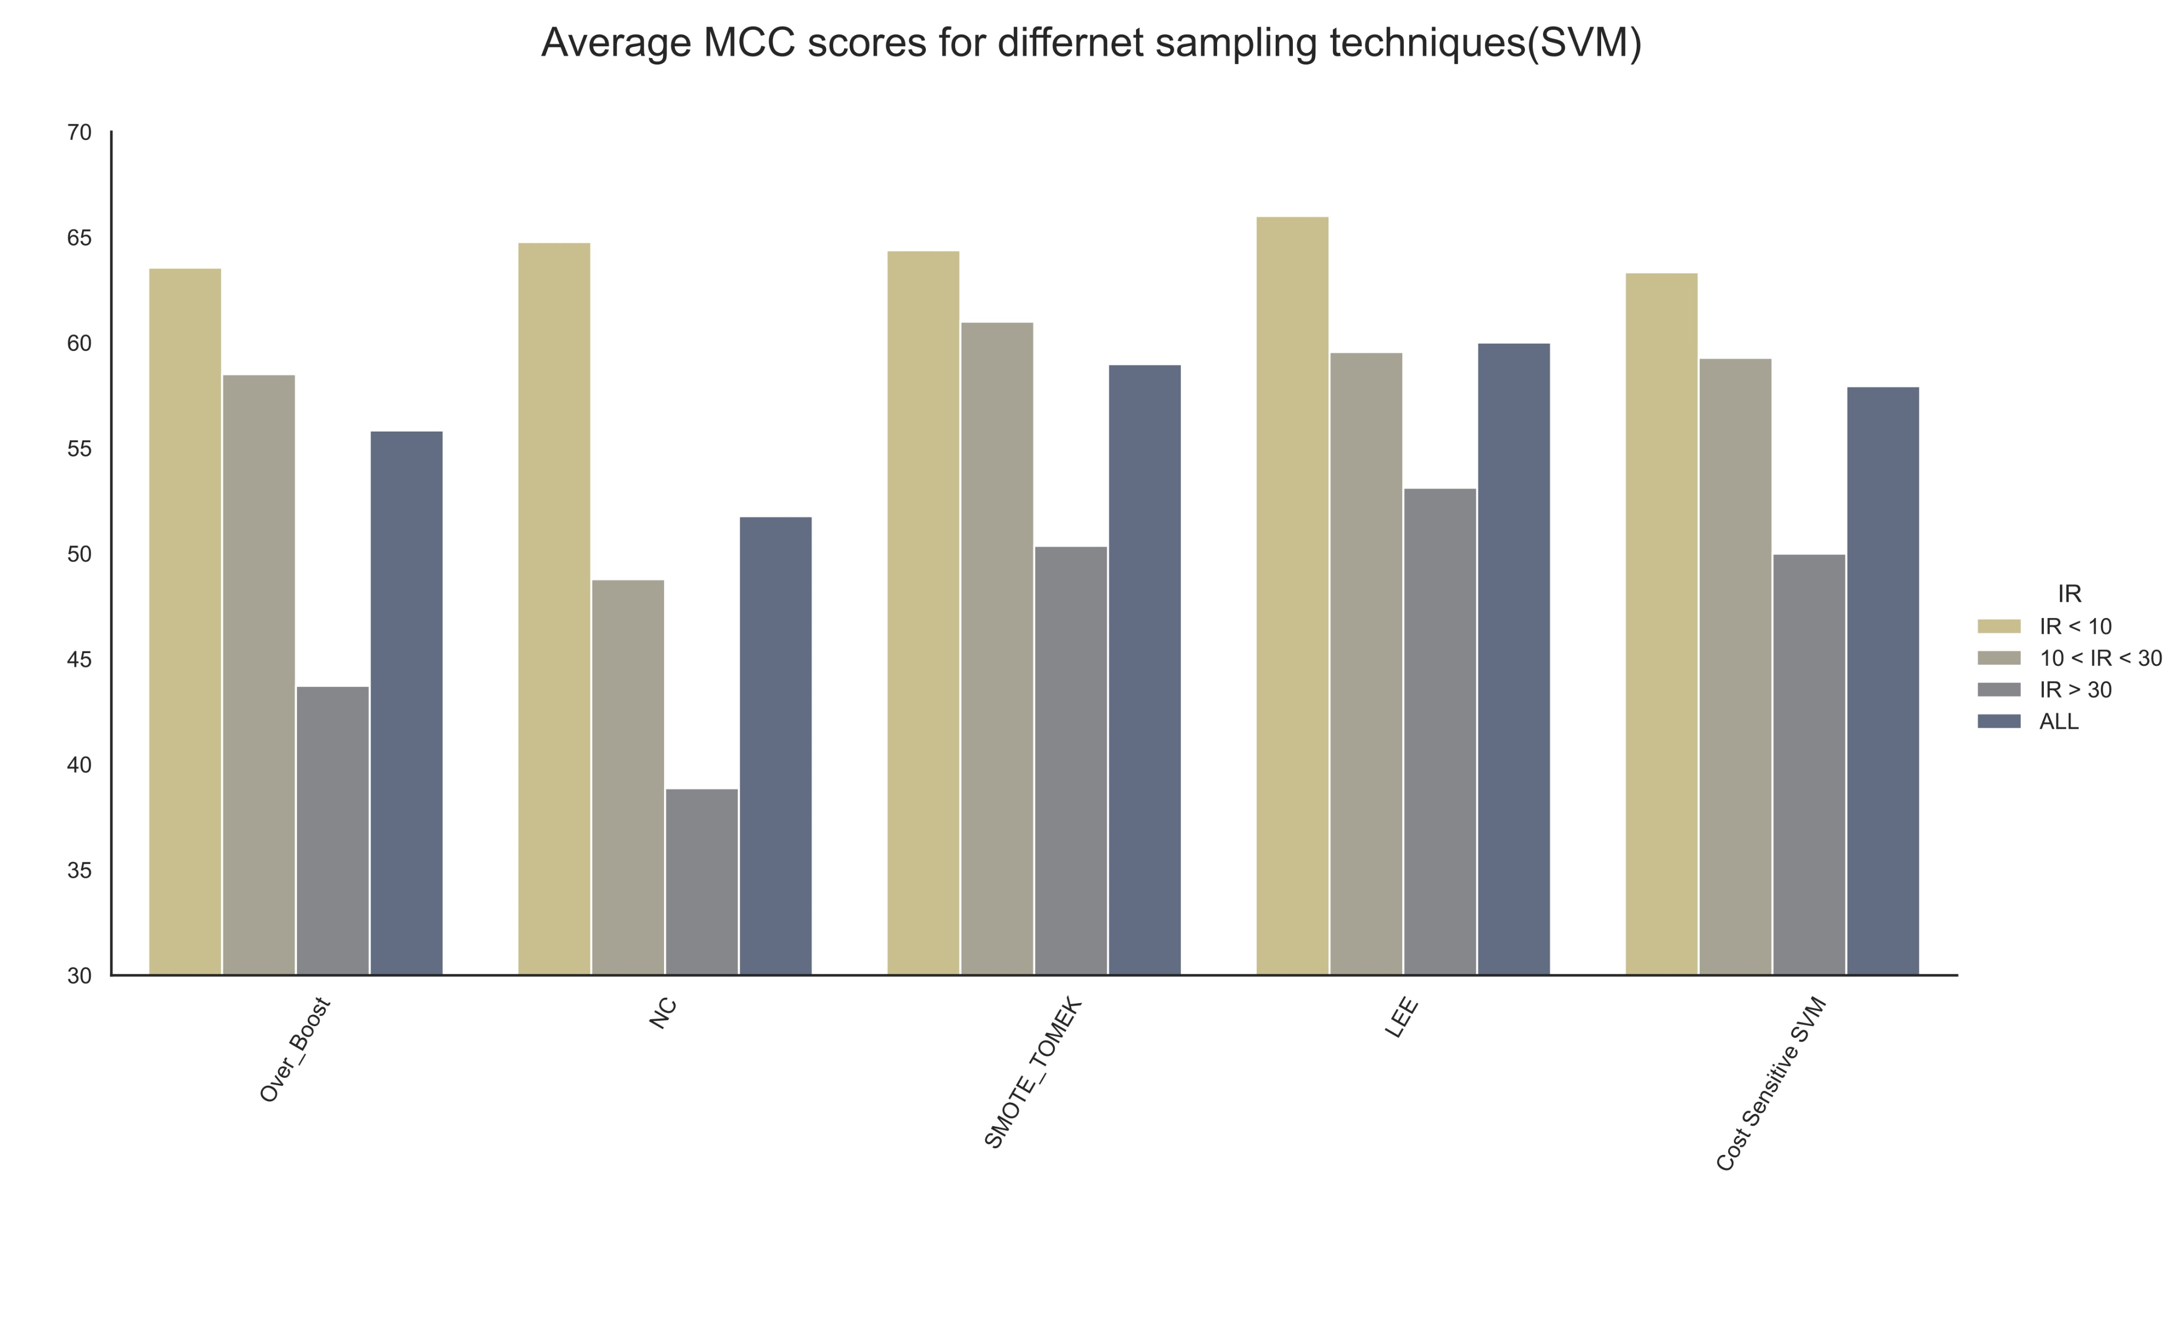
Performance Analysis of Cost-sensitive Learning
Cost-sensitive techniques works quite well in different imbalanced scenarios, even in higher imbalances.
The performance is comparable with the OS approaches.
Oversampling techniques usually outperforms all the other approaches.

Slide 21
Major Limitations of Different Techniques (Oversampling)
Let us consider a scenario where the dataset has 10000 samples and an IR of about 100.
No. of samples in the minority class = 100
No. of samples in the majority class = 9900
Oversampling techniques will have to generate 9800 synthetic samples from just 100 samples to balance the data. This will create the following problems –
Many of the synthesized instances may not match the characteristics of the original minority class.
Samples are generated arbitrarily, without any specific selection criteria for interpolation.
Excessive oversampling leads to overfitting.
Potential generation of noisy samples.
Increased overlapping.
As new samples are generated, the dataset size is increased – almost doubled.

Slide 22
Major Limitations of Different Techniques (Undersampling)
Undersampling techniques will have to eliminate 9800 samples from the majority class to balance the data. This will create the following problems –
Substantial loss of information.
Poor prediction performance on majority-class.
Overlap-based approaches do not usually remove so many instances, keeping the data quite imbalanced even after sampling.
Do not increase the presence of rare samples in the region making it challenging for the classifier to learn patterns.

Slide 23
Major Limitations of Different Techniques (Hybrid sampling and Ensembles)
Hybridization between oversampling and undersampling may palliate the situation but it does not solve the original issues associated with the techniques.
Ensemble mechanism does not solve the class imbalance issue. Integrating oversampling or undersampling do not have desirable effect if the original problem is not solved.

Slide 24
Major Limitations of Different Techniques (Cost Sensitive Learning)
In traditional Cost-sensitive learning, all minority-class instances would be penalized 100 times more than any majority-class instances.
This can lead to an unusual distortion of the decision boundary.
Imposing unnecessarily high penalties on minority-class samples located far from the decision boundary biases predictions toward the minority class.
This causes overfitting and loss of generalization.

Slide 25
Solutions
Based on the key insights drawn from the experimental analysis conducted as well as related literature review, 4 different novel approaches have been proposed.
iCost: An Instance Complexity Based Cost-Sensitive Learning Framework
UniSyn: A Unified Sampling Framework to Jointly Address Class Imbalance and Overlapping
iBRF: An improved Balanced Random Forest Classifier
A hierarchical decomposition strategy for multiclass classification

Slide 26
iCost: An Instance Complexity Based CSL Framework
Traditional classification algorithms: All misclassifications are treated equally (penalty=1)
Traditional Cost-Sensitive classifiers: Minority-class instances are penalized heavily than majority-class.
(In the default sklearn implementation, for a dataset with IR=15, misclassification cost of 15 is assigned to the minority class instances)
Assigning a higher penalty for misclassification deforms the decision boundary – shifting the bias away from the majority-class instances towards the minority-class.
Fig. 12: Effect of modifying weights of instances.

Slide 27
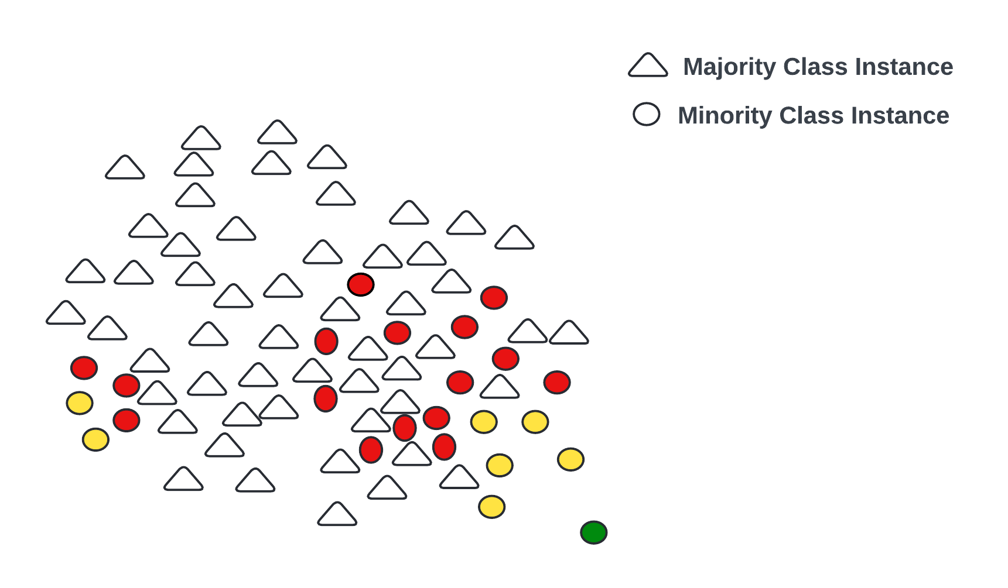
iCost: An Instance Complexity Based CSL Framework
Issue: All the minority-class instances are treated (penalized) equally.
However, not all the instances pose the same level of learning difficulty.
Samples closer to the decision boundary are more likely to be misclassified than those farther away.
Penalizing all the instances with the same penalty factor can deform the decision boundary creating an unusual bias towards the minority class and poor generalization/performance during testing.
Fig. 13: Instance-level difficulty

Slide 28
iCost: An Instance Complexity Based CSL Framework
Solution: Categorize the minority-class instances based on their difficulty levels.
Approach: Neighborhood search algorithm (identifying the nearest neighbors of each instances)
Higher misclassification costs are assigned to hard-to-learn instances in the overlapping regions, while samples in safe zones, surrounded by samples of the same class, are given marginal weights.
This provides a more plausible weighting mechanism.

Slide 29
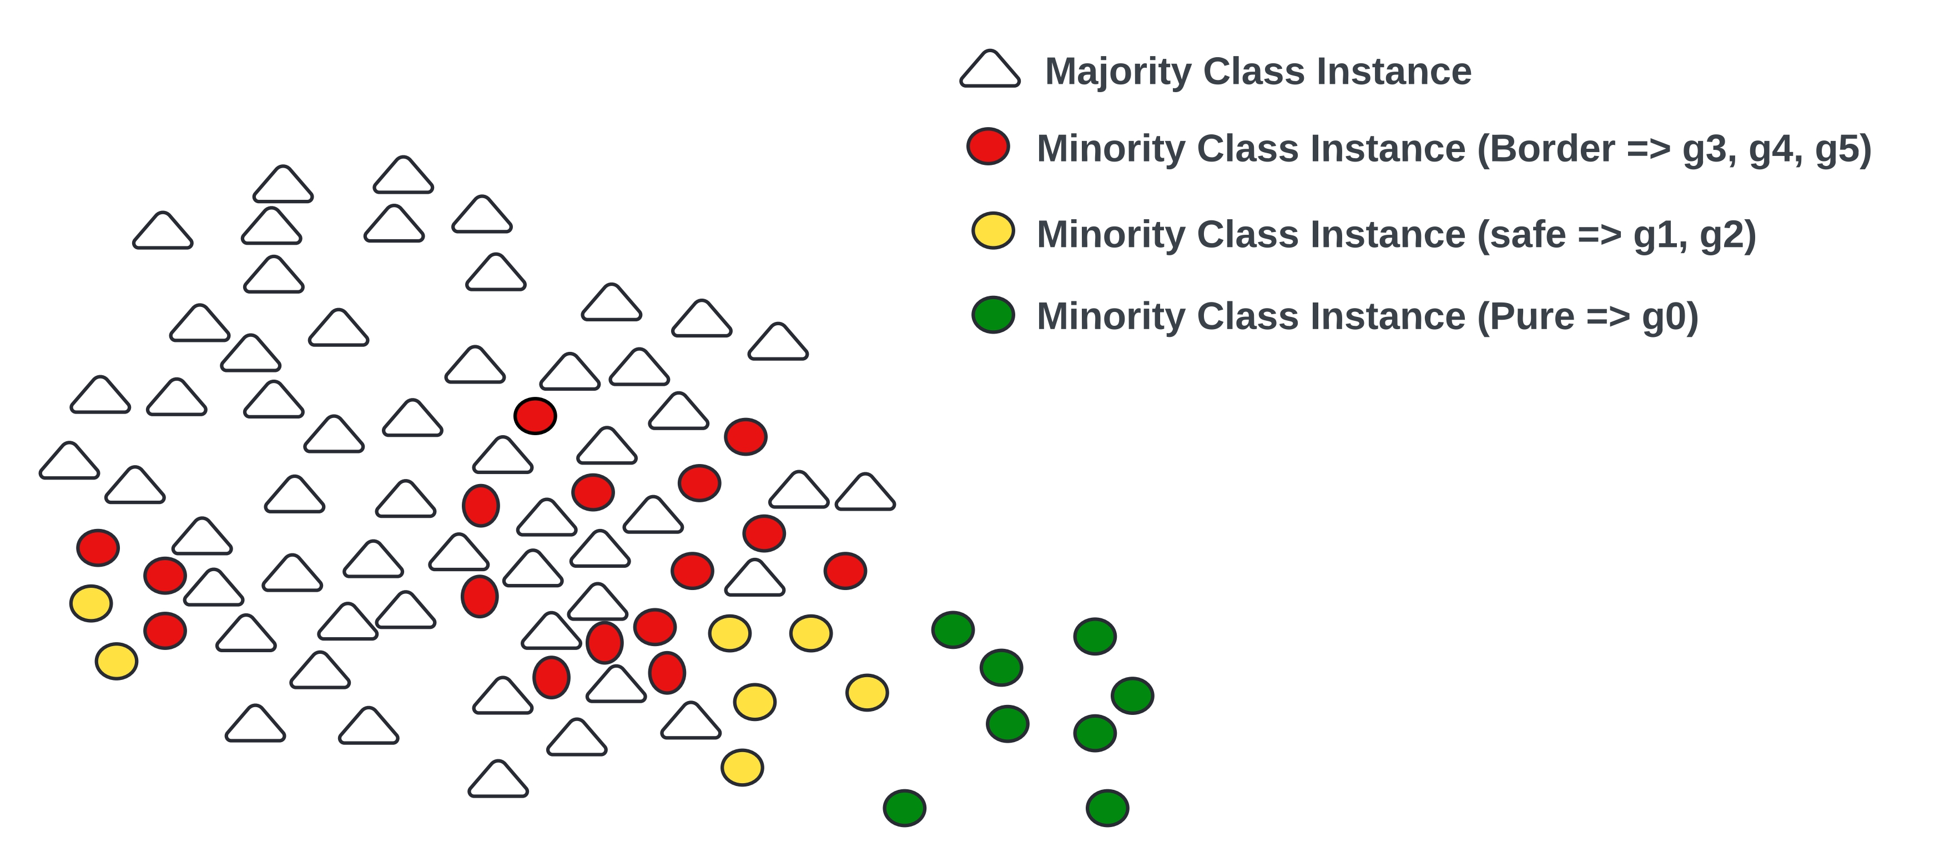
iCost: An Instance Complexity Based CSL Framework
Categorization:
Pure: No neighboring samples belong to the majority class.
Safe: One or two neighboring samples belong to the majority class.
Border: More than two neighboring samples belong to the majority class.
For generalization, each minority-class sample from g0 to g5, corresponding to having 0 to 5 neighboring majority-class samples, respectively.
Fig. 14: Minority-class categorization

Slide 30
iCost Algorithm Implementation
Implemented using Python.
Inheriting from sklearn classifiers.
Classifier: SVM, DT, LR
Type: org, ins, gen, nap
No. of neighbors: integer, k>=3 (default=5)
Cost-factor: list, dictionary or integer.
iCost(data, classifier = ‘SVM’, type = ‘ins’, cost-factor = [20, 10, 3])
A penalty of 20 will be set for the border samples while a penalty of 10 will be set for the safe ones. The pure samples will be penalized by a factor of 3.
The appropriate penalty values can be determined through grid-search, evolutionary algorithms, or similar methods.

Slide 31
Experimental Setup
Parameter | Value | Cost-factor parameter setting
Type | org | 0.75*IR, 0.9*IR, IR, 1.1*IR, 1.25*IR
 | ins | ‘pure' : [1, 0.1*IR, 0.2*IR] 'safe': [0.25*IR, 0.35*IR, 0.5*IR] ‘border': [0.75*IR, 0.9*IR, IR, 1.1*IR, 1.25*IR]
3 classifiers – SVM, LR, DT.
66 imbalanced datasets.
Repeated stratified cross-validation (5 folds, 10 repeats)
Type = ins, No. of neighbors: 5
The penalty factors were tuned using the grid-search technique.
Penalty > 1

Slide 32
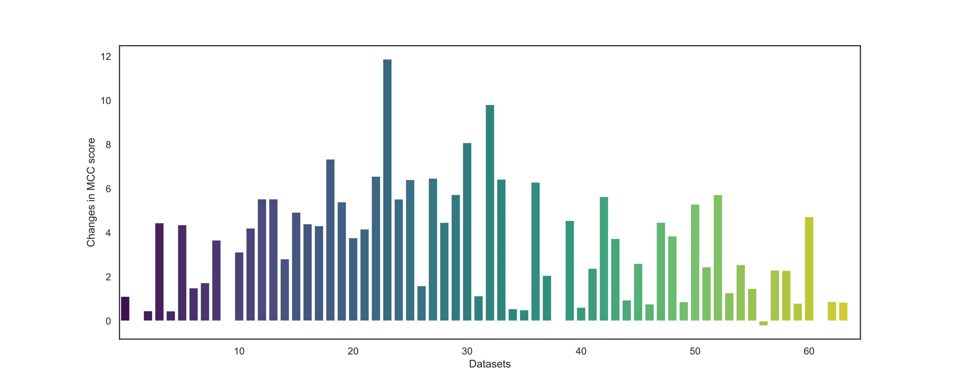
Changes in MCC score from the iCost algorithm as compared to traditional CS approach for the LR classifier

Slide 33
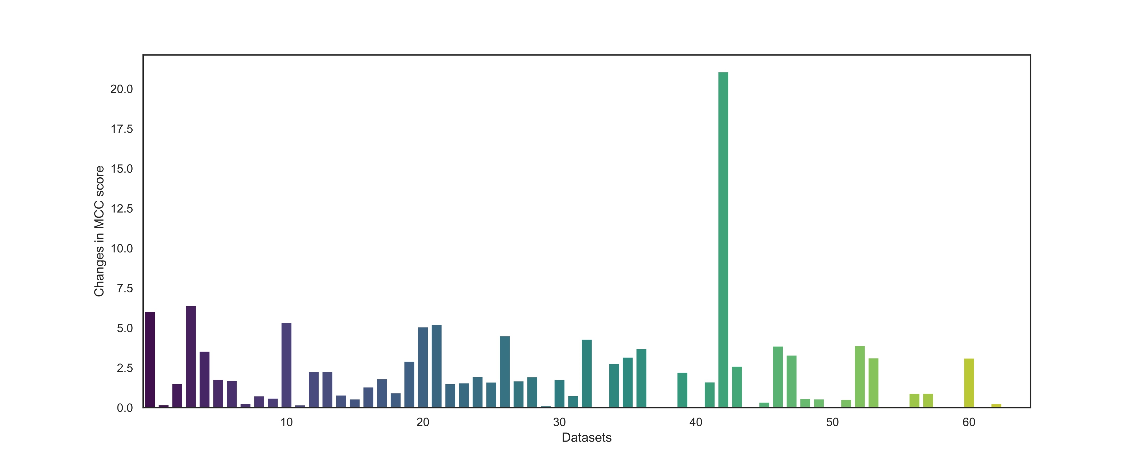
Changes in MCC score from the iCost algorithm as compared to traditional CS approach for the SVM classifier

Slide 34
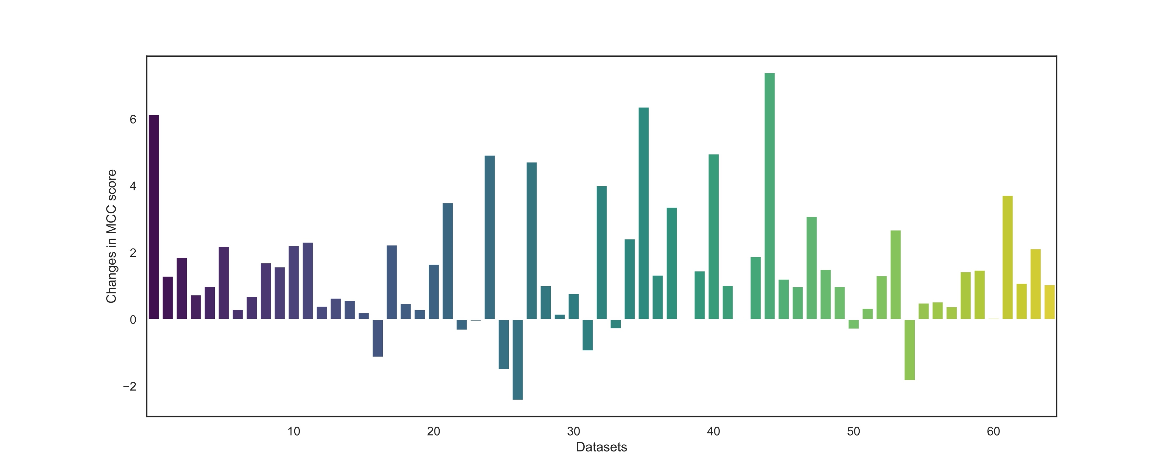
Changes in MCC score from the iCost algorithm as compared to traditional CS approach for the DT classifier

Slide 35
Performance Comparison with other approaches
Metrics | LR | SMOTE | ADASYN | BL-SMOTE | ROS | RUS | ENN | NC | SMOTE_Tomek | Easy Ensemble | RUSBoost | CS-LR | iCost (Proposed)
Sensitivity | 18.34 | 79.88 | 80.81 | 78.37 | 80.02 | 80.19 | 25.83 | 25.91 | 79.98 | 84.25 | 71.92 | 80.21 | 78.43
Specificity | 99.16 | 80.46 | 78.16 | 80.77 | 79.70 | 75.16 | 96.40 | 96.30 | 80.44 | 78.30 | 84.80 | 83.26 | 85.47
Precision | 33.64 | 46.70 | 42.75 | 45.56 | 45.46 | 41.65 | 36.05 | 37.31 | 46.69 | 43.31 | 45.68 | 41.87 | 47.13
ROC-AUC | 58.75 | 80.17 | 79.48 | 79.57 | 79.86 | 77.67 | 61.11 | 61.10 | 80.21 | 81.28 | 78.36 | 81.73 | 81.95
G-mean | 24.79 | 77.62 | 76.57 | 76.11 | 76.87 | 74.48 | 30.79 | 30.95 | 77.63 | 79.26 | 74.11 | 80.29 | 81.03
MCC | 21.72 | 49.50 | 46.80 | 48.72 | 48.58 | 44.18 | 25.96 | 26.21 | 49.53 | 48.96 | 47.53 | 48.2 | 51.56
F1-score | 21.81 | 52.47 | 49.94 | 51.90 | 51.53 | 47.50 | 27.83 | 28.10 | 52.46 | 50.71 | 50.62 | 50.57 | 53.96

Slide 36
UniSyn: A Unified Sampling Framework to Jointly Address Class Imbalance and Overlapping
There are several data difficulty factors which complicate the learning process in imbalanced data.
IR: Simply balancing the class distribution does not ensure enhanced performance. It leads to other issues such as loss of information if too many samples are eliminated.
Overlap: If overlap is not addressed during the process, the situation may not improve. A classifier can perform well even with high imbalance levels if there is no overlap.
Rare samples: The presence of rare samples in the vicinity need to be increased. However, creating too many synthetic samples can cause overfitting.
Noisy samples: Real-world datasets often comes with noisy instances. Synthetic samples generation process also introduces noisy samples which need to be taken care of.

Slide 37
UniSyn: A Unified Sampling Framework
All the data difficulty factors need to be properly addressed for desirable performance.
These factors are interconnected and intertwined.
Generation or elimination of samples also produces other issues that need to be taken care of.
The proposed methodology is aimed at attaining a balance while simultaneously addressing the data difficulty factors and minimizing the drawbacks of sampling approaches.

Slide 38
Methodology
The proposed sampling approach is divided into three stages.
Oversampling: A modified version of the SMOTE algorithm used to increase the presence of minority-class instances.
The SMOTE algorithm is modified to minimize certain shortcomings of the original approach.
Data Cleaning: To reduce overlapping and to remove noisy instances, neighborhood cleaning rule (NCL) is applied.
Undersampling: Random undersampling is utilized to reduce the class imbalance to a small extent.
These three stages combinedly produces the framework for the proposed UniSyn algorithm.

Slide 39
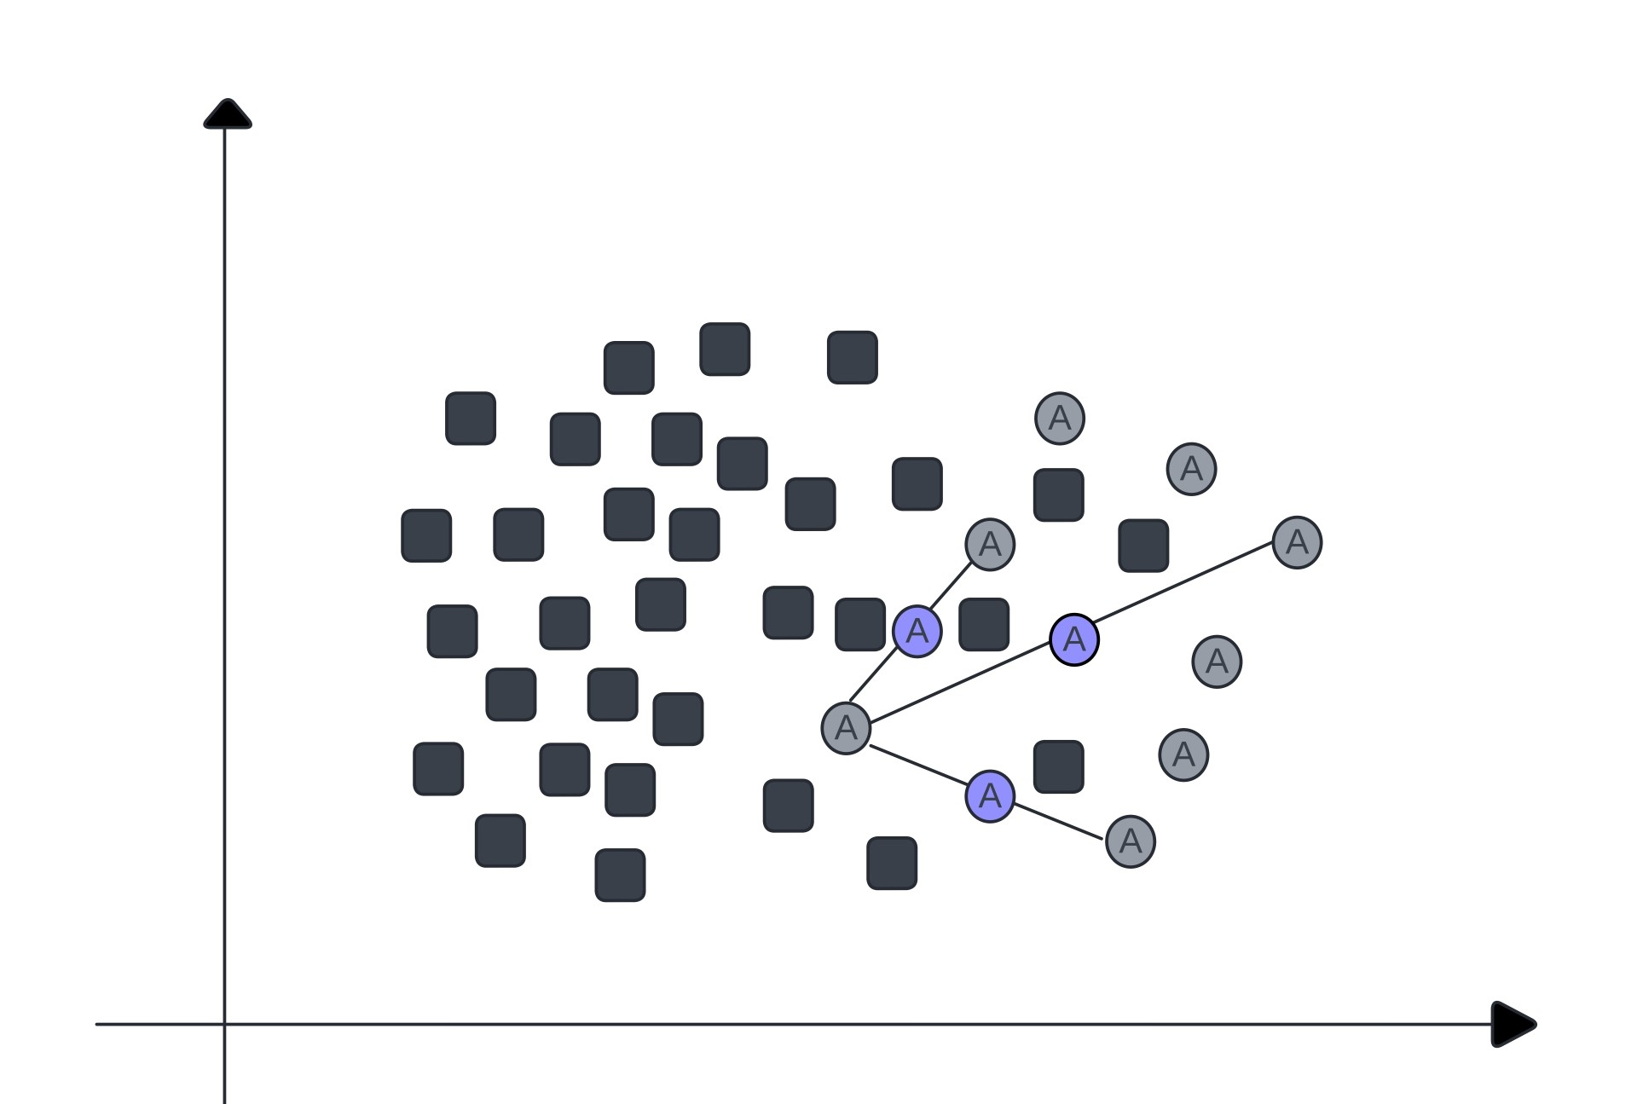
Methodology - Oversampling
To achieve good sensitivity, increasing the presence of minority-class samples is essential.
Issues –
Generating too many synthetic samples to balance the data can cause overfitting.
SMOTE and its variants generate samples indiscriminately, without specific selection criteria for interpolation.
This raises the chance of producing samples that do not accurately represent the original class (noisy samples).
Increased overlapping.
Fig. 18: Data synthesis using SMOTE

Slide 40
Methodology - Oversampling
Solutions:
Limit the number of instances to be generated (controlled by a hyperparameter α)
Balance is achieved through a combination of multiple resampling techniques.
A customized version of the SMOTE algorithm is developed.
Minority-class instances are categorized based on their complexity level. Samples are synthesized carefully to ensure faithful generation.
A noise removal algorithm is applied in the subsequent stage to get rid of the noisy instances to reduce overlapping.

Slide 41
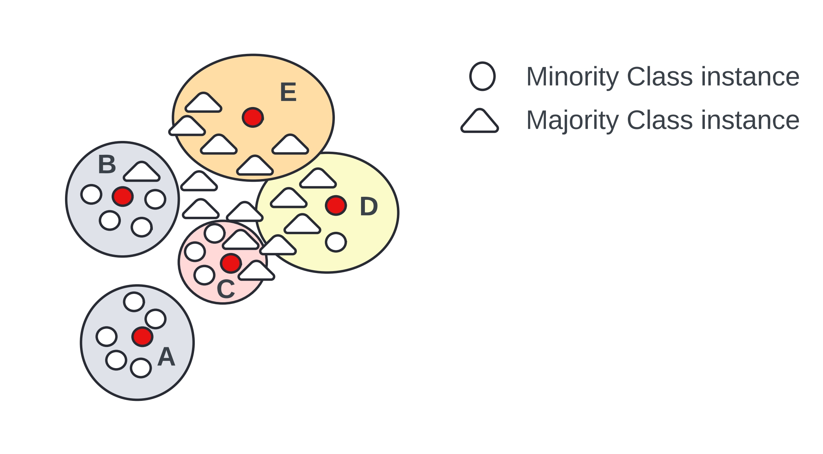
Modified SMOTE algorithm
Minority class samples are categorized into three types:
Safe: At most one neighbor from the opposite class.
Border: 2, 3 or 4 neighbors from the opposite class.
Outlier: Entirely surrounded by opposite class.
Only border samples are used in synthesis.
Fig. 19: Instance categorization
Considering the outlier-type instances for synthesis would cause the generation of noisy instances.
Safe samples are away from the decision boundary. Synthesizing new samples there is less likely to aid in classification.

Slide 42
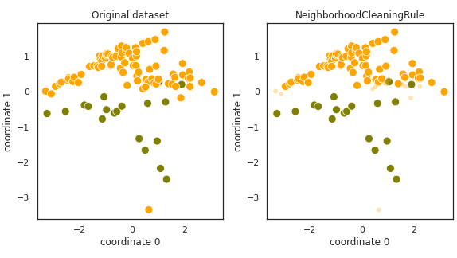
Methodology – Data cleaning
NCL rule is applied to eliminate majority-class samples that can be considered noisy [4].
NCL employs k-nearest neighbors (k=3) for classifying each instances.
If the original sample belongs to the majority class and is misclassified by its neighbors, it is removed from the data.
if the original sample belongs to the minority class and is misclassified by its neighbors, the majority class neighbors are removed.
Fig. 20: Sample removal using NCL
[4] J. Laurikkala, “Improving identification of difficult small classes by balancing class distribution,” in Artificial Intelligence in Medicine: 8th Conference on Artificial Intelligence in Medicine in Europe, AIME 2001 Cascais, Portugal, July 1–4, 2001, Proceedings 8. Springer, 2001, pp. 63–66.

Slide 43
Methodology – Data cleaning
This stage accomplishes three goals.
It clears the decision boundary of noisy samples.
It reduces class overlap, which improves learning.
It lowers the imbalance ratio, though the reduction is relatively small (around 20%)
Data remains skewed even after sampling. The NCL algorithm alone cannot completely avoid bias.

Slide 44
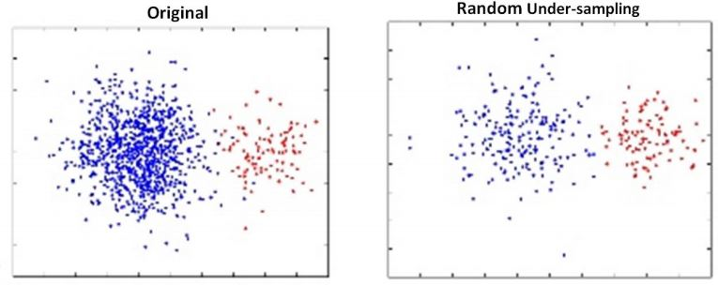
Methodology – Undersampling
If the data remains biased, satisfactory performance cannot be achieved.
Some majority class samples from the data are removed (randomly selected) to further reduce the IR.
Removing too many samples can lead to a loss of information, which can negatively affect performance.
Only a limited number of instances (around 20%) are removed in this stage controlled by a hyperparameter (β).
These three stages collectively form the proposed sampling framework.
α and β values can be optimized using grid-search (default, α=0.5, β =0.2).
Fig. 21: Sample removal using RUS

Slide 45
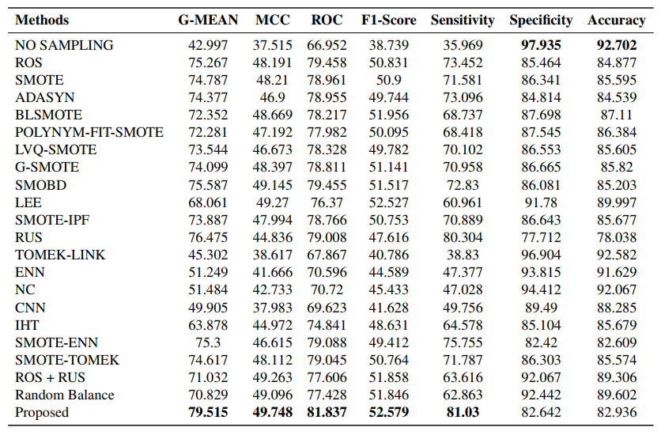
Performance Measures
Results using the SVM classifier

Slide 46
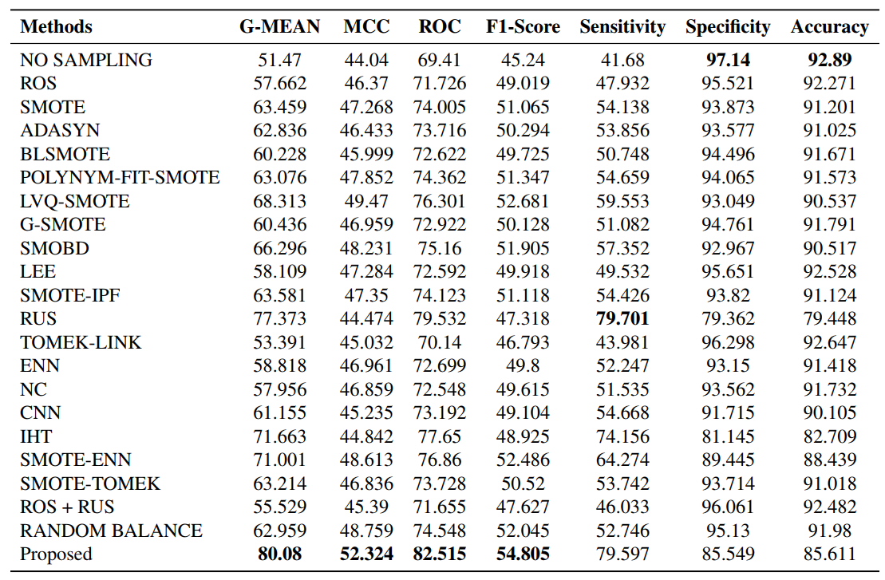
Performance Measures
Results using the RF classifier

Slide 47
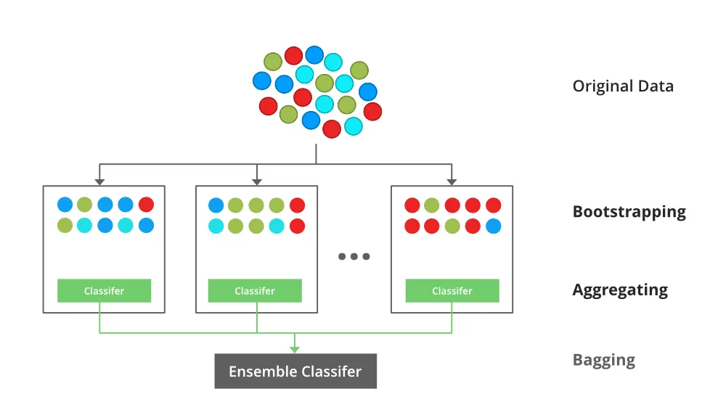
iBRF: Improved Balanced Random Forest Classifier
The proposed UniSyn technique is integrated into a modified bagging framework.
In bagging, bootstrap samples are generated from the original data through random sampling with replacement, producing multiple bootstrap samples that are potentially different from the original dataset.
Weak learners are then trained on a different subset of the original data, resulting in better generalization.
RF is an extension of bagging that involves an additional layer of randomness through random feature selection at each node.

Slide 48
Modified Bagging Framework for Imbalanced Data
Issue:
If the data is skewed, the bootstrap subsets would be even more skewed.
Some subsets might lack minority-class samples entirely.
Solution:
Include all minority-class samples in each bootstrap subset.
Majority-class samples are then added with replacement.

Slide 49
Balanced Random Forest Classifier (BRF)
Originally proposed by Chen et al.[5]
In the case of imbalanced data, each bootstrap subset remain skewed.
Random Undersampling (RUS) is used to balance each bootstrap subset.
Issue:
RUS removes too many samples to balance the data.
Loss of information and poor performance.
If #majority = 10000 and #minority = 100, 9900 samples will be removed by the RUS algorithm to attain balance.
[5] C. Chen, A. Liaw, L. Breiman et al., “Using random forest to learn imbalanced data,” University of California, Berkeley, vol. 110, no. 1-12, p. 24, 2004

Slide 50
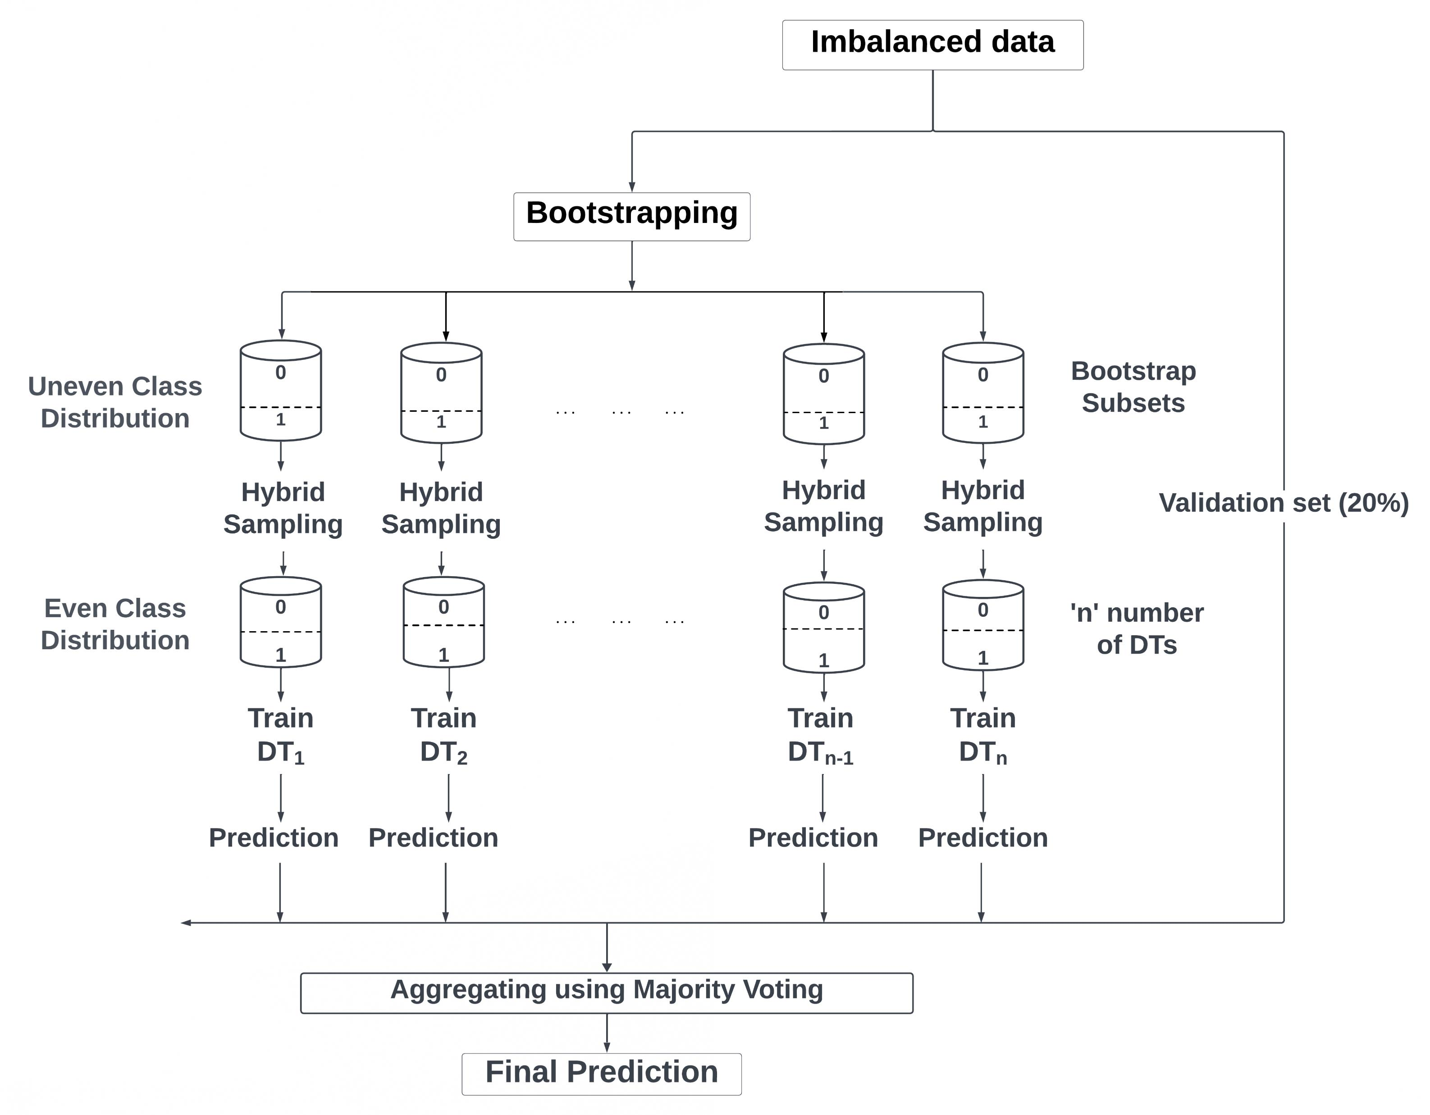
iBRF: Improved Balanced Random Forest Classifier
In the place of RUS, the UniSyn sampling algorithm is utilized to adequately balance each bootstrap subset.
In the proposed UniSyn approach, only around 20% samples are removed using RUS, limiting information loss.
Integrating the UniSyn algorithm into the modified bagging framework produces enhanced prediction performance.

Slide 51
Benefits
Reduced information loss: In one subset, certain samples might be removed. But in another subset, those samples might still be present and used to train a different classifier. Thus, using a large number (typically 100) of bootstrap subsets reduces the issue of information loss.
Better generalization: Since classifiers are trained on a different subset of the original data, the resultant ensemble approach is well-generalized and provide far more robust prediction performance.

Slide 52
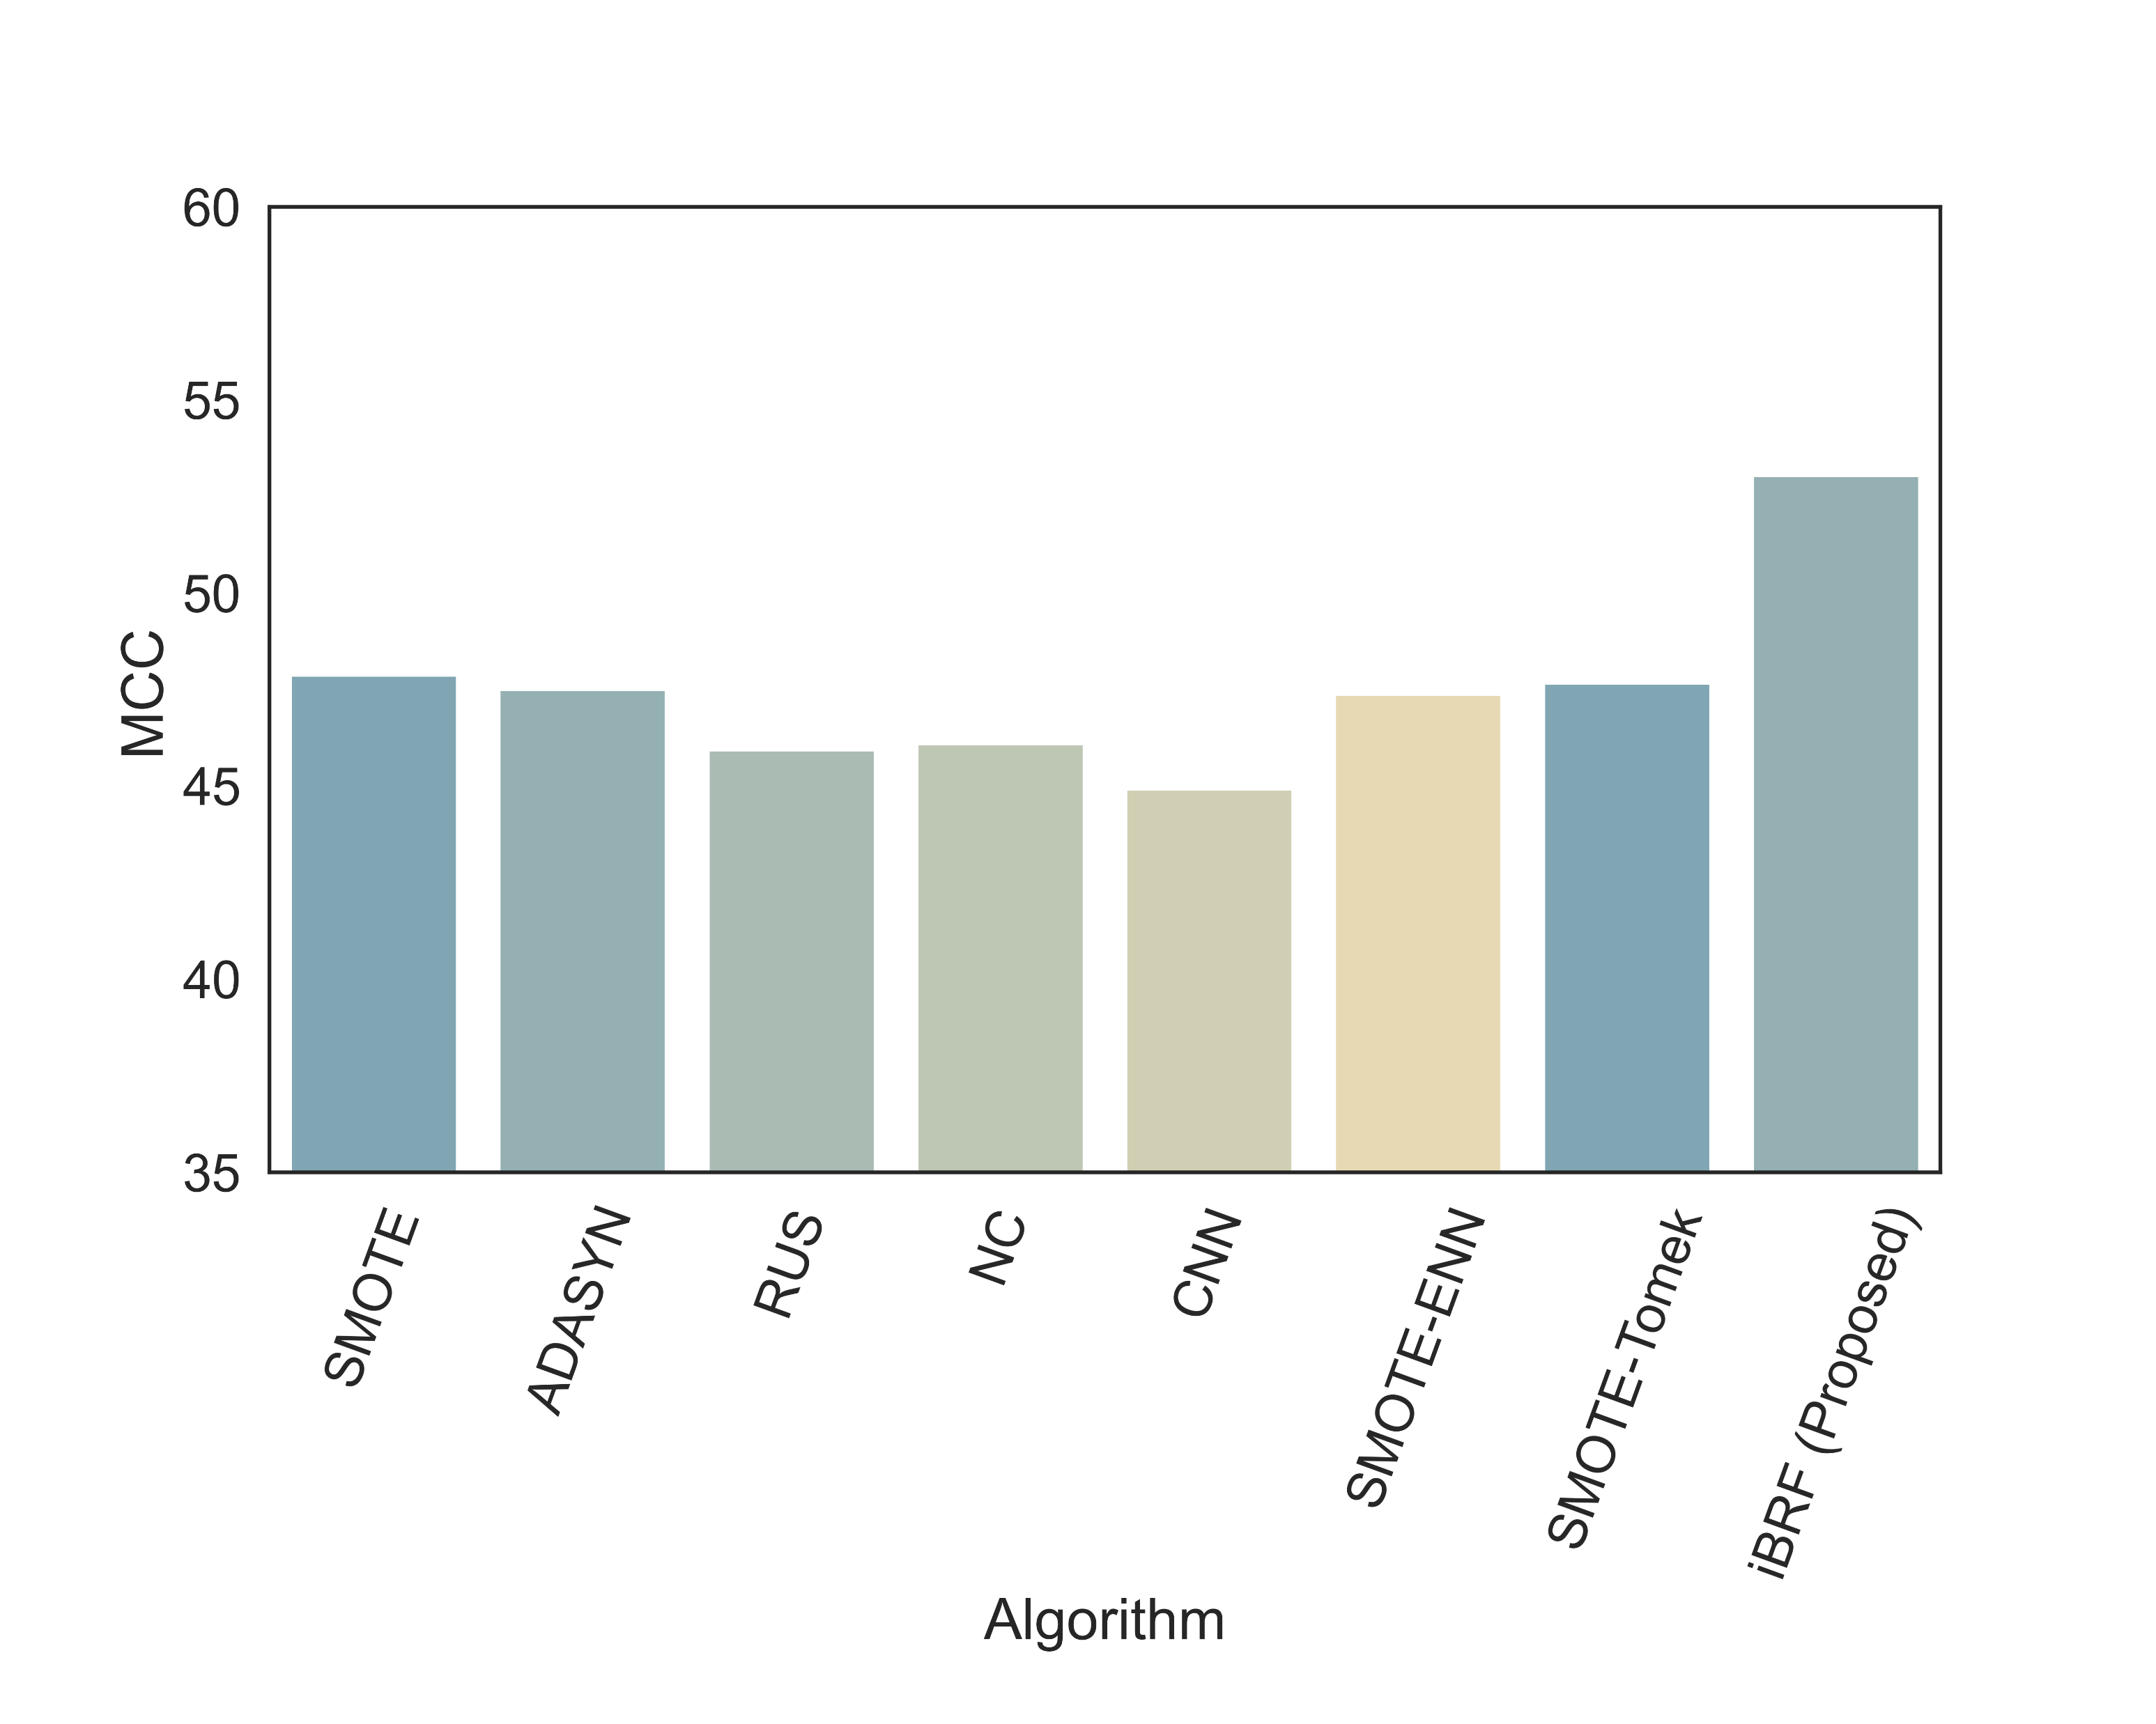
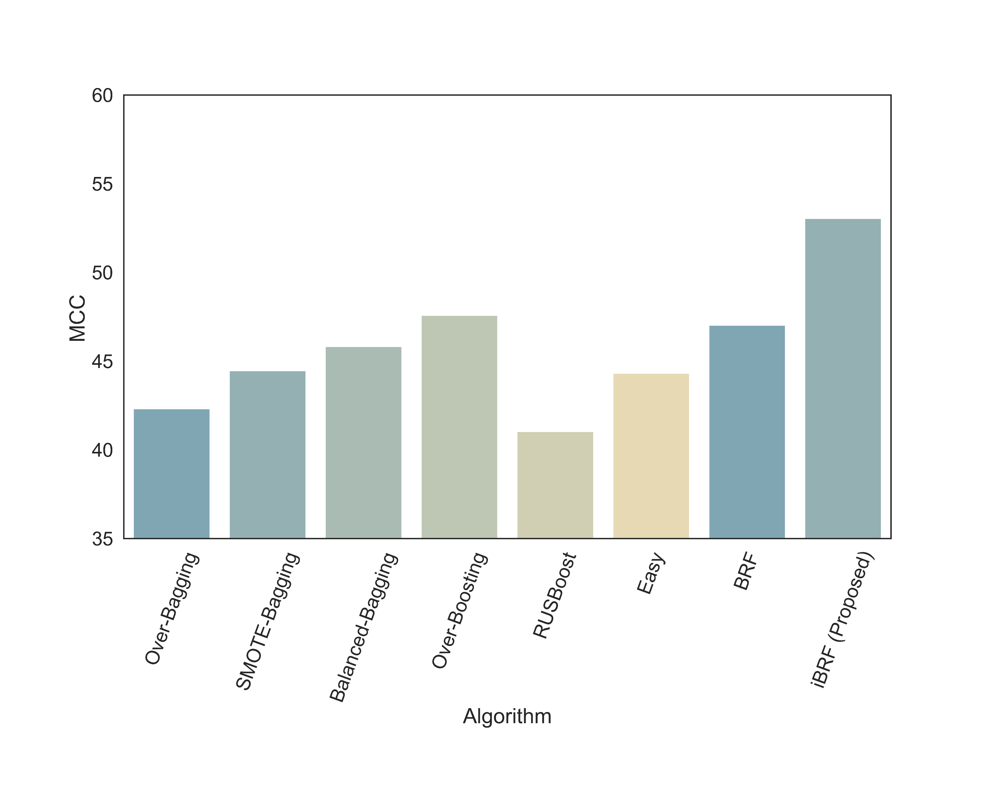
Performance Comparison

Slide 53
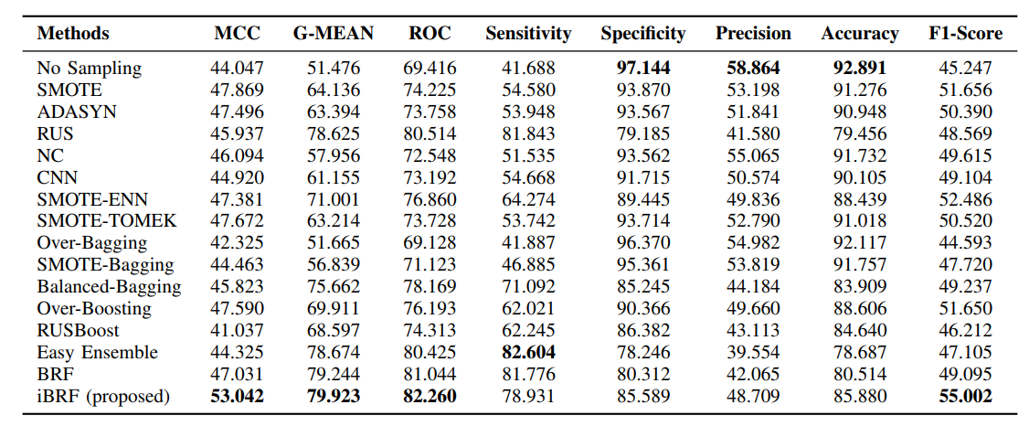
Performance Measures

Slide 54
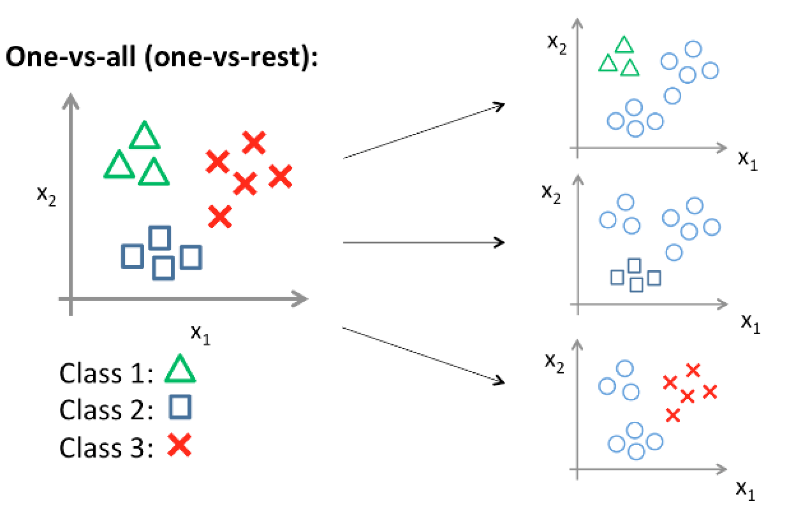
A novel multilevel decomposition strategy for multiclass classification
Multiclass imbalanced classification scenarios are far more complicated than binary ones.
One-vs-One (OVO) and One-vs-All (OVA) are two different decomposition strategies.
They divide the entire multiclass problem into smaller binary ones.
Fig. 25: OVA strategy (cc.gatech.edu)

Slide 55
Issues With Traditional Decomposition Strategy
Resultant data with binary classes can become quite imbalanced even if the original classes are even.
The problem becomes far more complicated when the data is imbalanced, which is more common in different applications.
Consequently, traditional approaches produce very poor performance on the rare classes.

Slide 56
Proposed Strategy
Traditional methods don’t take into consideration any of the data characteristics like class imbalance or overlapping.
The proposed strategy is to perform classification in multiple stages using a hierarchical framework.
Perform decomposition based on class imbalance or overlapping (minimize it)
Gradually move towards smaller value.

Slide 57
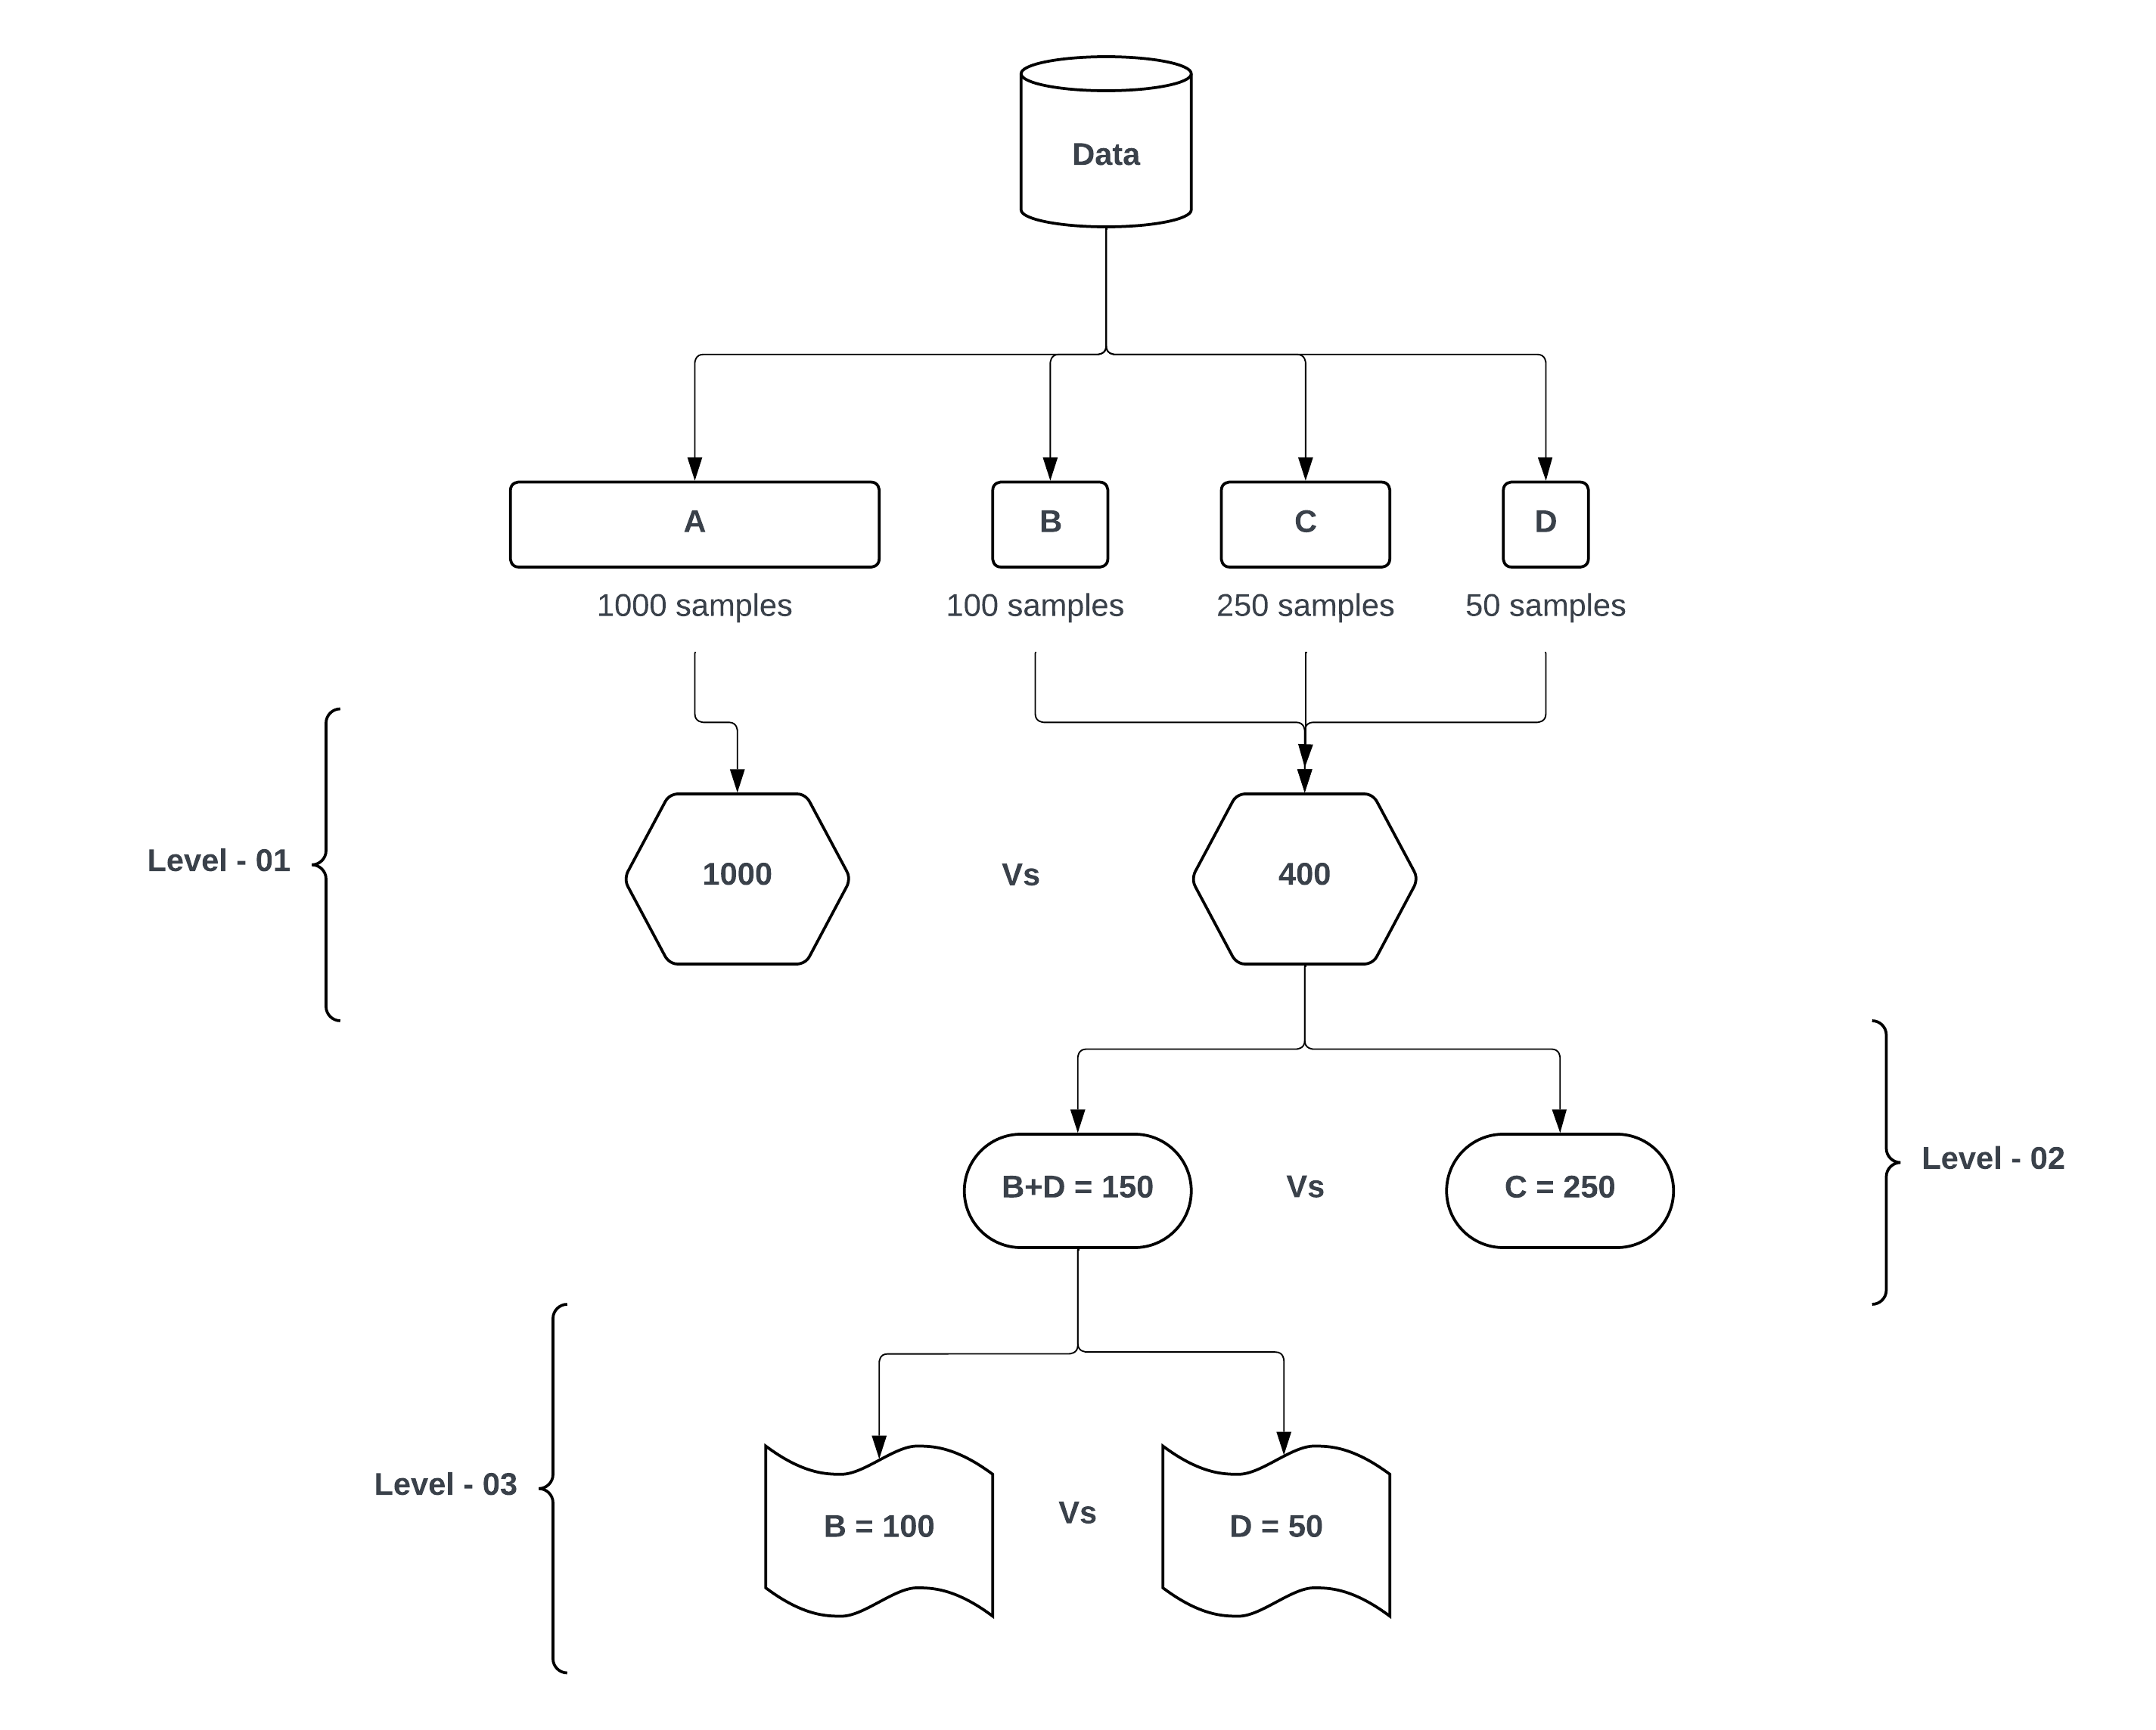
Multilevel Decomposition Framework

Slide 58
Limitations and Future Work
iCost
Instance complexity was assessed based on nearest neighbors. There are other data complexity measures such as local sets that can be utilized as well.
Outlier type instance category was not addressed separately. Since penalizing outliers is likely to increase overfitting, they should be tested with limited weights.
UniSyn
When dealing with heavily imbalanced data with very few minority-class instances, SMOTE struggles to create representative samples. Given that ML algorithms are highly data-dependent, overcoming this representational bottleneck poses a significant challenge.

Slide 59
Limitations and Future Work
iBRF
Boosting framework can be utilized.
Can be more time consuming in large datasets.
Multilevel Decomposition Framework
The work is currently in progress. While initial observations demonstrated promising results, further modifications (such as decomposition based on class overlapping) in the framework is possible.
More computational time.

Slide 60

Conclusion
In this thesis, new venues in the imbalanced domain have been explored.
New approaches based on instance characteristics have been developed.
The proposed approaches show promising results.
This research gives a new direction in the imbalanced domain and paves the way for the development of new strategies that are based on data-specific characteristics.

Slide 61
Publications
Published
Newaz, A., Mohosheu, M.S., Al Noman, M.A. and Jabid, T., 2024, April. iBRF: Improved Balanced Random Forest Classifier. In 2024 35th Conference of Open Innovations Association (FRUCT) (pp. 501-508). IEEE. DOI: https://doi.org/10.23919/FRUCT61870.2024.10516372.
Mohosheu, M.S., al Noman, M.A., Newaz, A. and Jabid, T., 2024, May. A Comprehensive Evaluation of Sampling Techniques in Addressing Class Imbalance Across Diverse Datasets. In 2024 6th International Conference on Electrical Engineering and Information and Communication Technology (ICEEICT) (pp. 1008-1013). IEEE. DOI: https://doi.org/10.1109/ICEEICT62016.2024.10534464.
Under Review
Newaz, A., Jabid, T. “iCost: A Novel Instance Complexity Based Cost-Sensitive Learning Framework for Imbalanced Classification.” [Under review in ICDM – 2024]
Newaz, A., Mohosheu, M.S., Jabid, T. “A Unified Sampling Framework to Jointly Address Class Imbalance and Overlapping for Imbalanced Learning.” [under review in Knowledge and Information Systems journal]

Slide 62
Thank you

